Slide 1
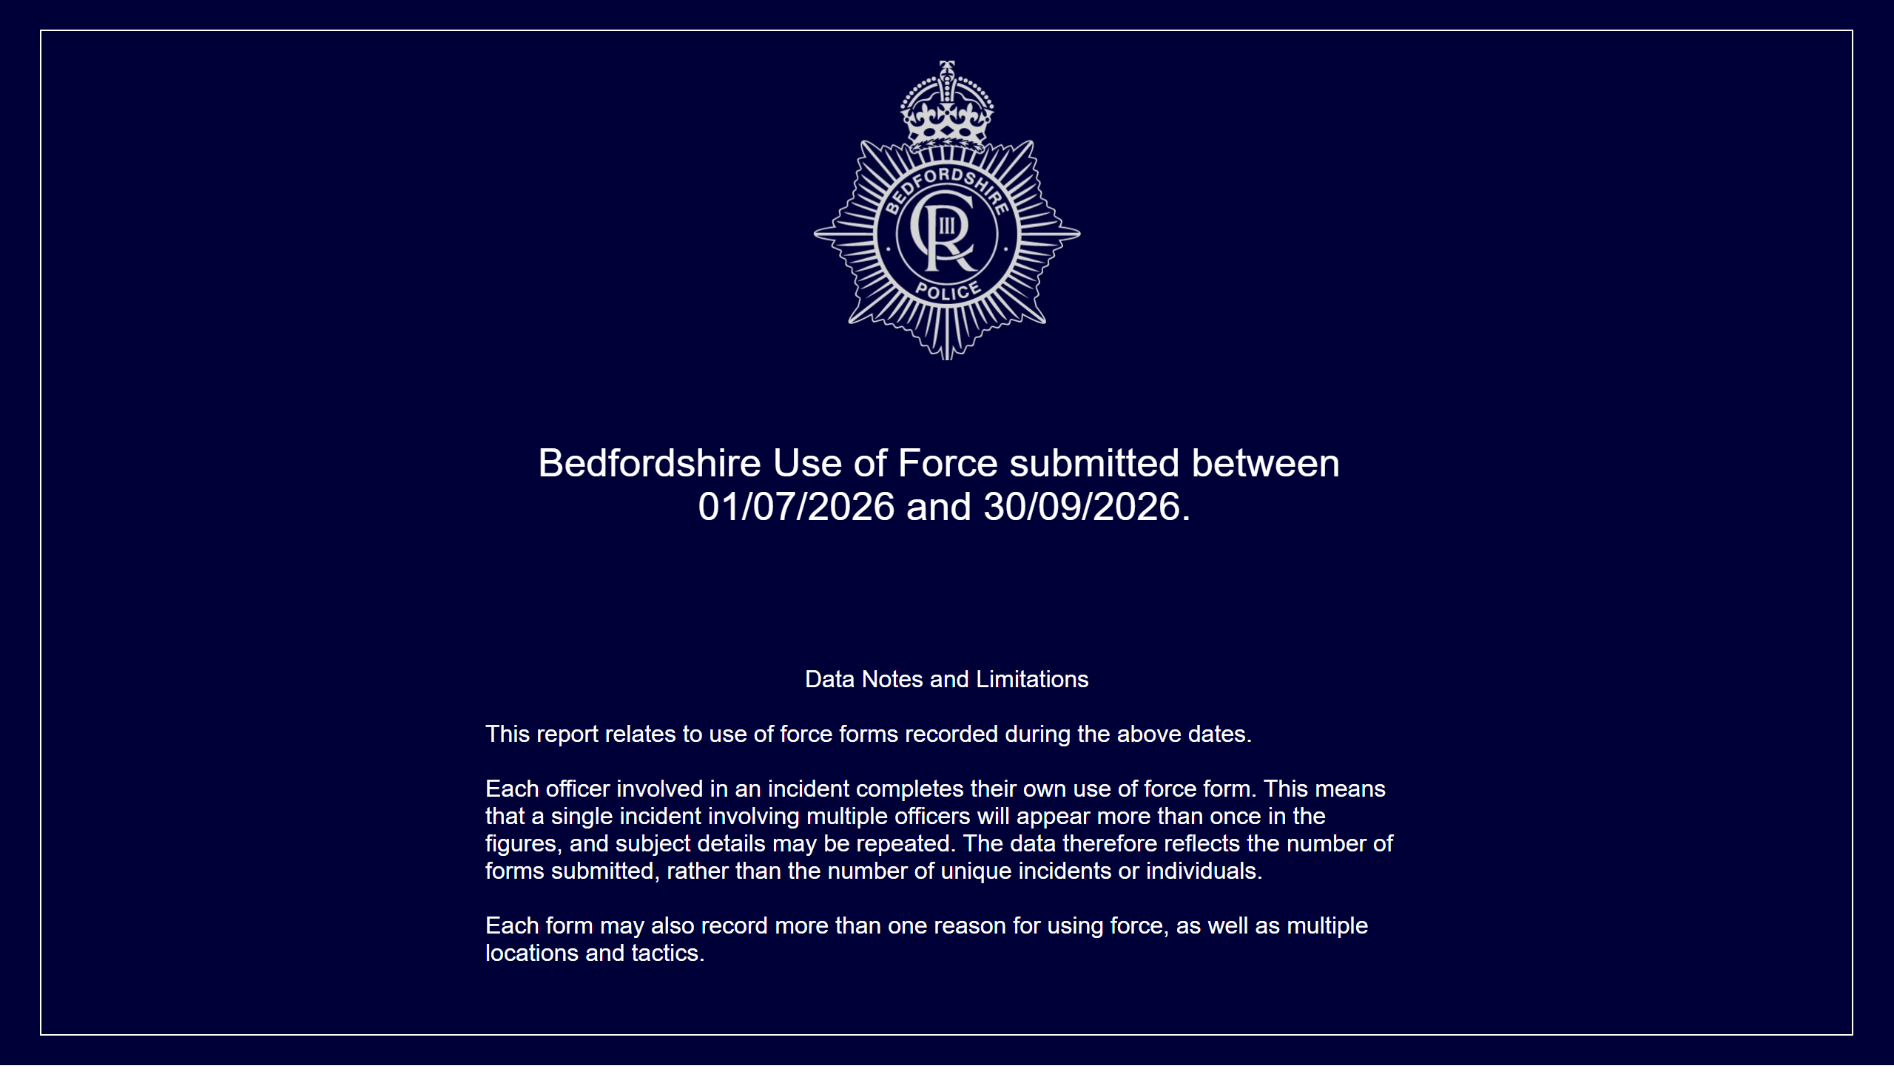
Front Page
Note: A system issue from late June into July 2026 affected the recording of use of force submissions and resulted in lower recorded figures during this period.
Notes:
Bedfordshire Use of Force submitted between 01/07/2026 and 30/09/2026.
Note: A system issue from late June into July 2026 affected the recording of use of force submissions and resulted in lower recorded figures during this period.
Data Notes and Limitations
This report relates to use of force forms recorded during the above dates.
Each officer involved in an incident completes their own use of force form. This means that a single incident involving multiple officers will appear more than once in the figures, and subject details may be repeated. The data therefore reflects the number of forms submitted, rather than the number of unique incidents or individuals.
Each form may also record more than one reason for using force, as well as multiple locations and tactics.

Slide 2
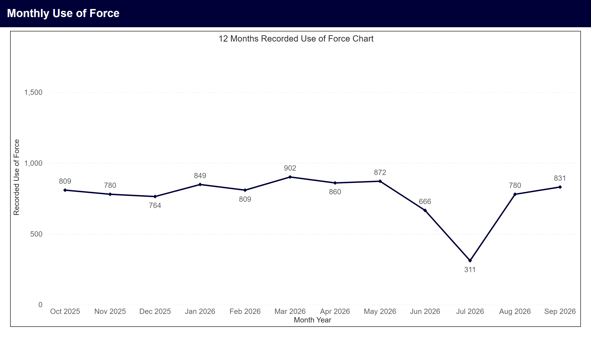
Monthly Use of Force
Note: A system issue from late June into July 2026 affected the recording of use of force submissions and resulted in lower recorded figures during this period.
Notes:
12 Months Recorded Use of Force Chart
Line chart showing monthly use of force records for the last 12 calendar months. An average of 769 records were recorded per month. Highest months were Mar 2026 with 902, May 2026 with 872, Apr 2026 with 860.
A system issue from late June into July 2026 affected the recording of use of force submissions and resulted in lower recorded figures during this period. Although the issue has since been resolved, data for June and July 2026 should be interpreted with caution when assessing trends over time.

Slide 3
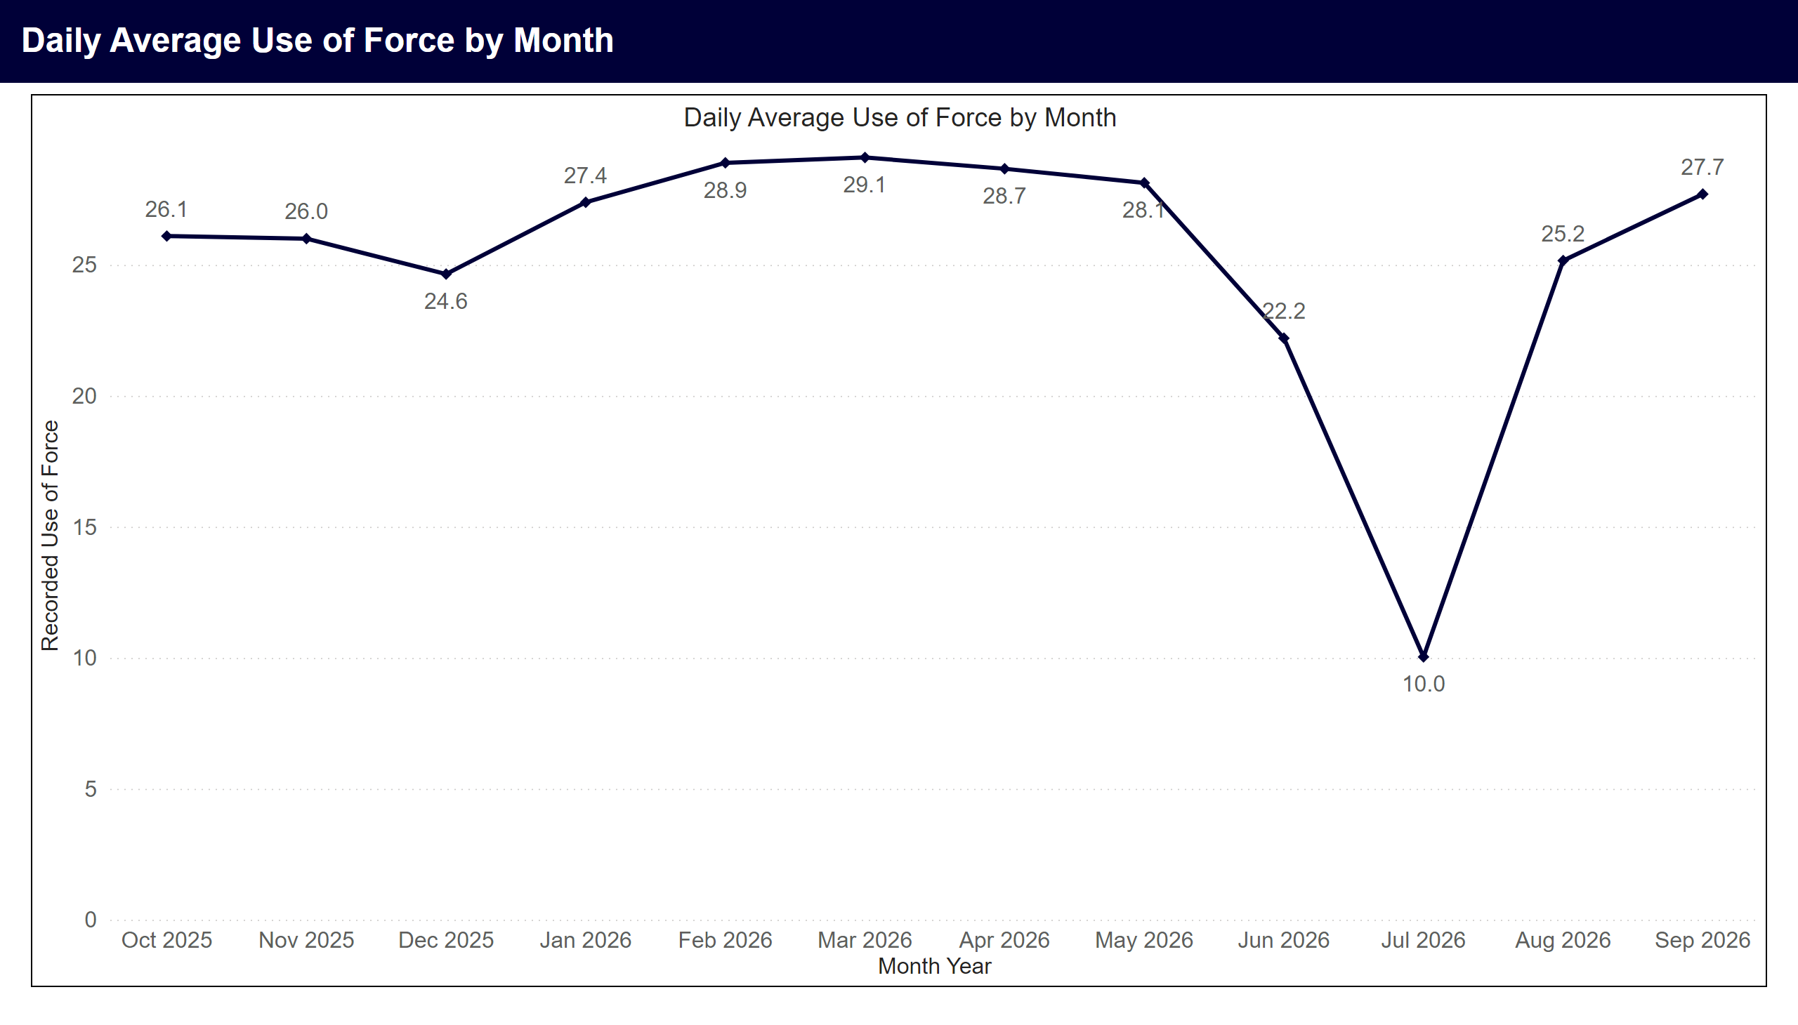
Daily Averages by Month
Note: A system issue from late June into July 2026 affected the recording of use of force submissions and resulted in lower recorded figures during this period.
Notes:
Daily Average Use of Force by Month
Line chart showing average daily use of force records by month. Highest months in period were Mar 2026 with 29.1, Feb 2026 with 28.9, Apr 2026 with 28.7.
A system issue from late June into July 2026 affected the recording of use of force submissions and resulted in lower recorded figures during this period. Although the issue has since been resolved, data for June and July 2026 should be interpreted with caution when assessing trends over time.

Slide 4
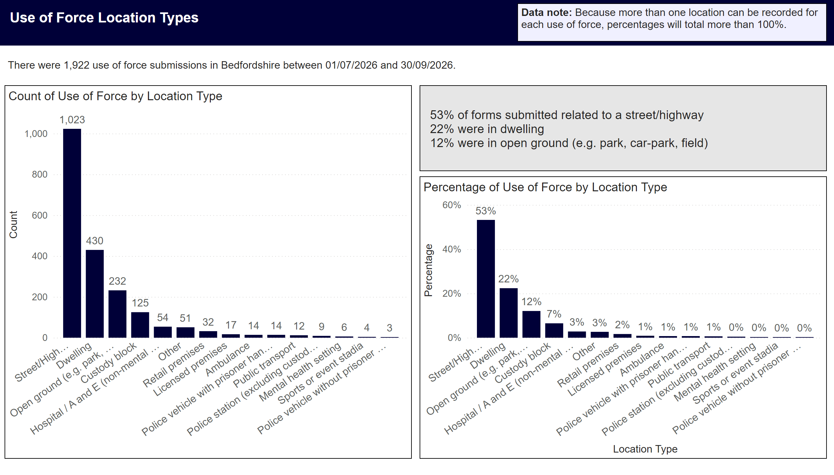
Location Type
Notes:
Data note: Because more than one location can be recorded for each use of force, percentages will total more than 100%.
Overview
There were 1,922 use of force submissions in Bedfordshire between 01/07/2026 and 30/09/2026.
Top Three locations by percentage
53% of forms submitted related to a street/highway
22% were in dwelling
12% were in open ground (e.g. park, car-park, field)
Count of Use of Force by Location Type
The top five use of force locations in the period were street/highway with 1,023, dwelling with 430, open ground (e.g. park, car-park, field) with 232, custody block with 125, hospital / a and e (non-mental health setting) with 54.
Percentage of Use of Force by Location Type
Bar chart showing percentage of use of force by location type.

Slide 5
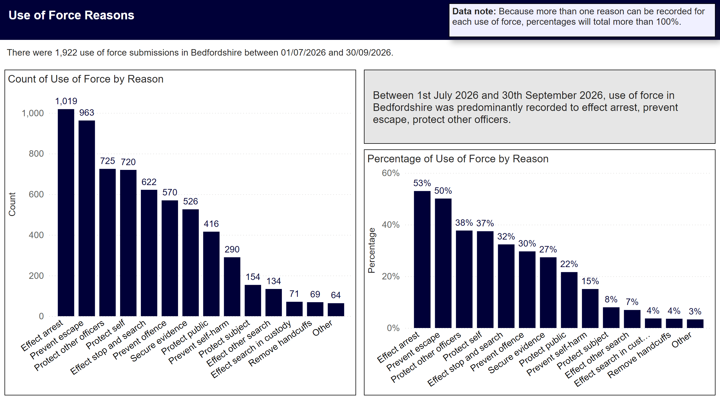
Reason
Notes:
Data note: Because more than one reason can be recorded for each use of force, percentages will total more than 100%.
Overview
There were 1,922 use of force submissions in Bedfordshire between 01/07/2026 and 30/09/2026.
Top Reasons for Use of Force in Period
Between 1st July 2026 and 30th September 2026, use of force in Bedfordshire was predominantly recorded to effect arrest, prevent escape, protect other officers.
Percentage of Use of Force by Reason
Bar chart showing percentage of use of force by reason
Count of Use of Force by Reason
Bar chart showing count of use of force by reason

Slide 6
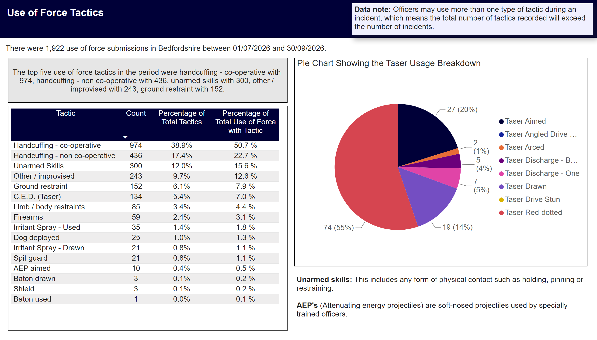
Tactics Used
Notes:
Use of Force Tactics
Data note: Officers may use more than one type of tactic during an incident, which means the total number of tactics recorded will exceed the number of incidents.
Overview
There were 1,922 use of force submissions in Bedfordshire between 01/07/2026 and 30/09/2026.
Top 5 Tactics Used
The top five use of force tactics in the period were handcuffing - co-operative with 974, handcuffing - non co-operative with 436, unarmed skills with 300, other / improvised with 243, ground restraint with 152.
Pie Chart Showing the Taser Usage Breakdown
Tasers were used in 134 instances of use of force in the period. 74 red-dotted, 27 aimed, 19 drawn, 0 angled drive stun, 2 arced, 12 discharged, 0 drive stun.
Table
Table showing count of use of force by tactic used. Percentage of total tactics, and percentage of total use of force with tactic.

Slide 7
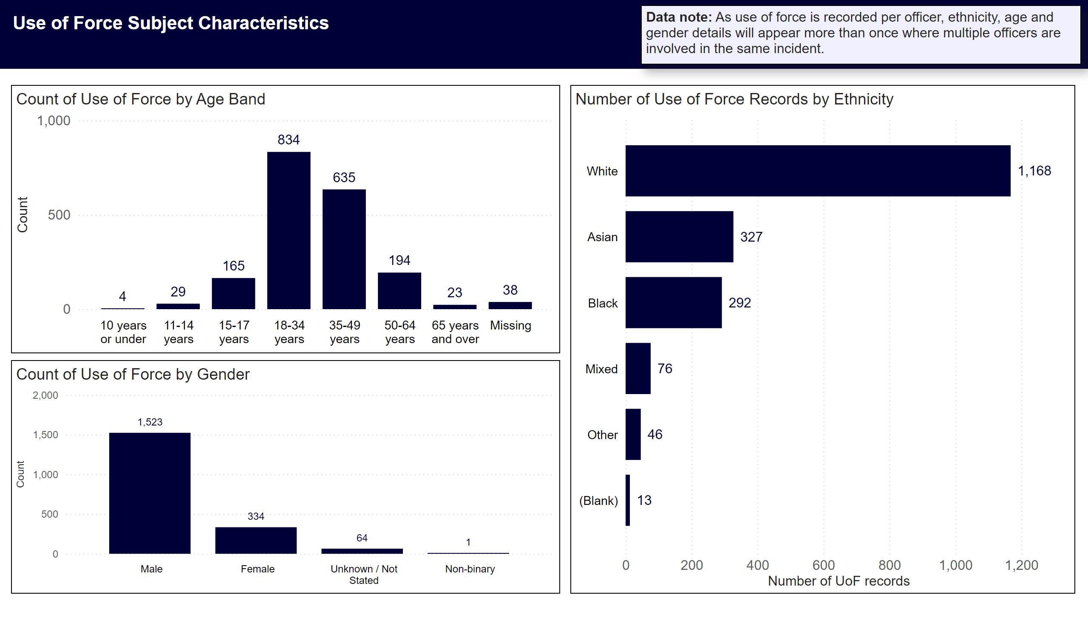
Subject Characteristics - Counts
Notes:
Use of Force Subject Characteristics
Number of Use of Force Records by Ethnicity
Ethnicity breakdown was as follows White with 1,168, Asian with 327, Black with 292, Mixed with 76, Other with 46.
Count of Use of Force by Age Band
Top three age bands were18-34 years with 834, 35-49 years with 635, 50-64 years with 194.
Count of Use of Force by Gender
Gender breakdown male 1,523, female 334.
Data Note
Data note: As use of force is recorded per officer, ethnicity, age and gender details will appear more than once where multiple officers are involved in the same incident.

Slide 8
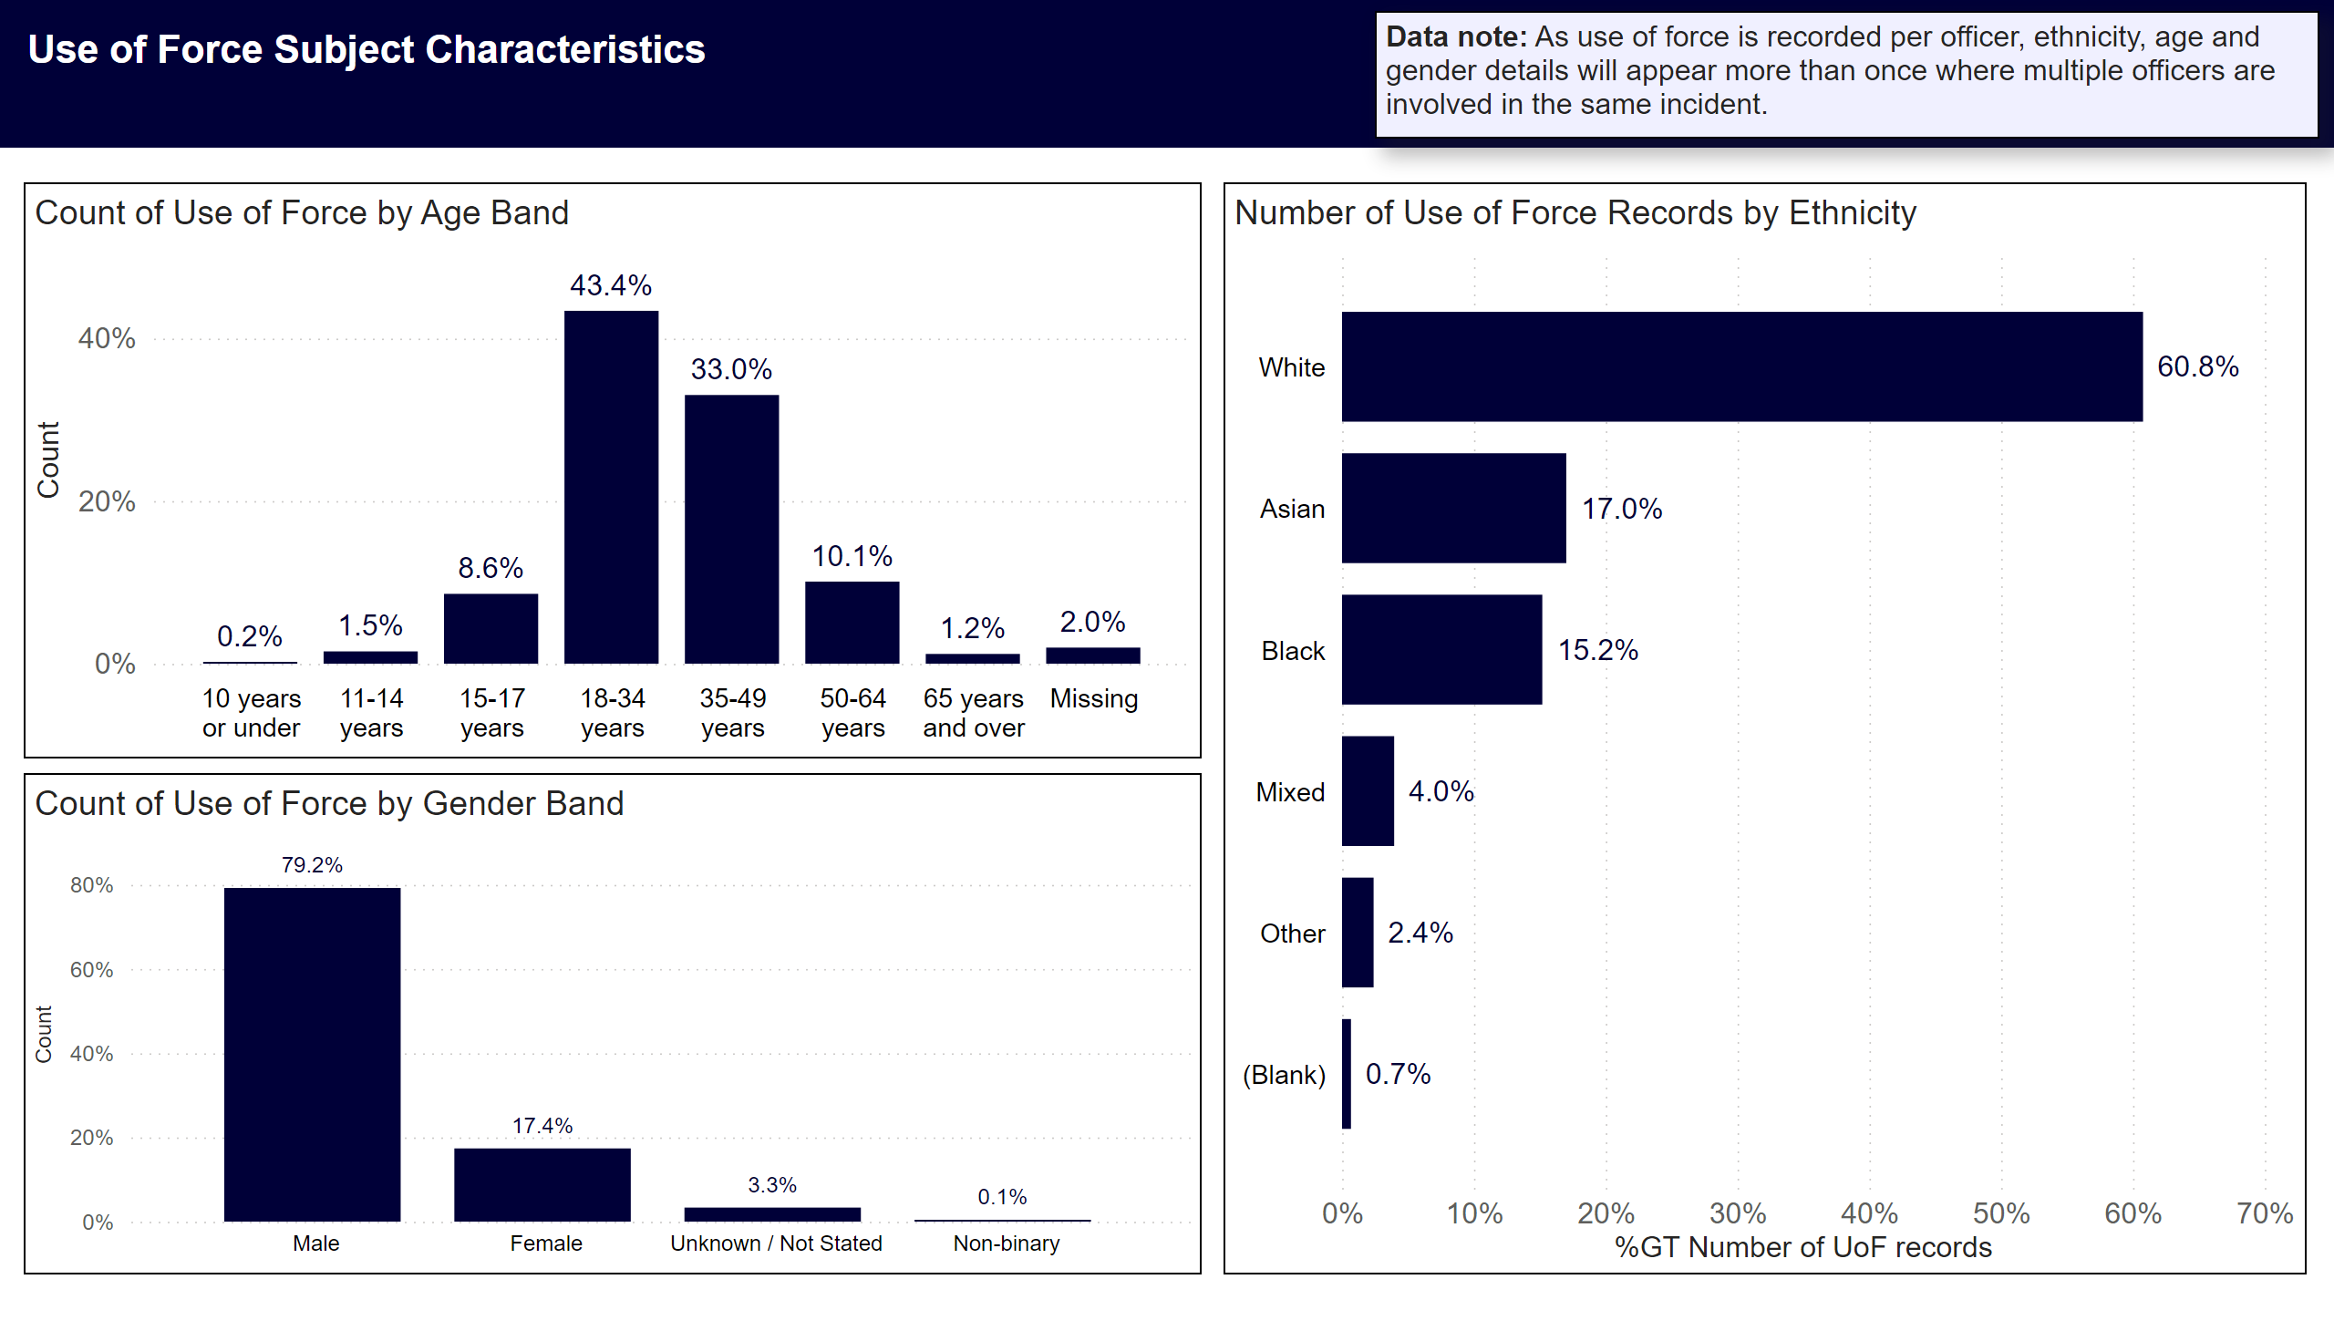
Subject Characteristics - Percentages
Notes:
Use of Force Subject Characteristics
Count of Use of Force by Age Band
43% of forms submitted related to persons aged 18-34 years
33% were 35-49 years
10% were 50-64 years
Count of Use of Force by Gender Band
79% of use of force subjects were male
17% were female
Number of Use of Force Records by Ethnicity
61% of subjects were White
17% were Asian
15% were Black
4% were Mixed
2% were Other
Data Note
Data note: As use of force is recorded per officer, ethnicity, age and gender details will appear more than once where multiple officers are involved in the same incident.

