Slide 1
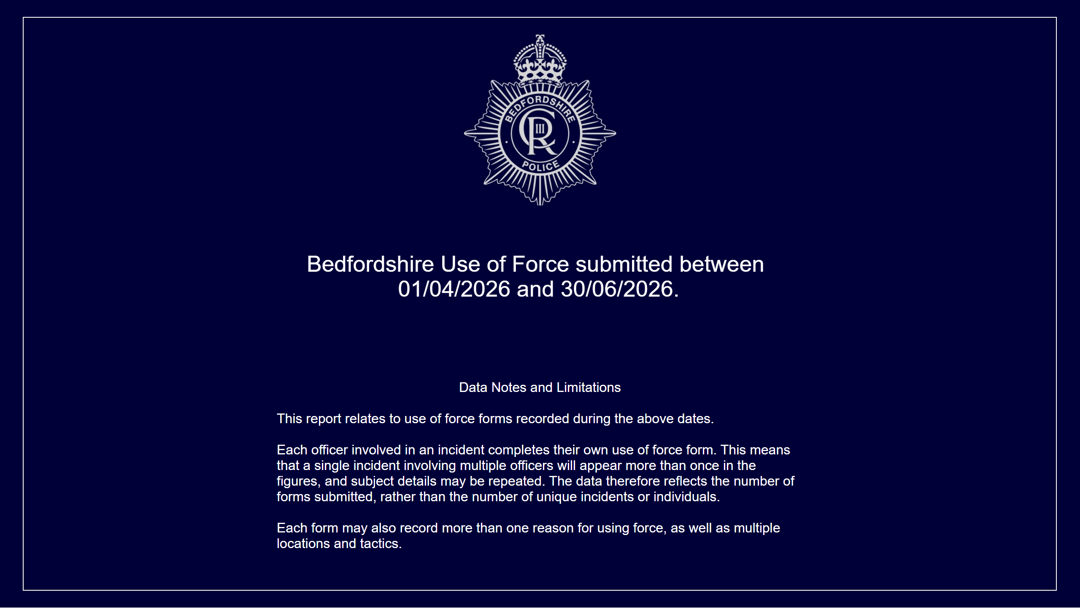
Front Page
Notes:
Data Notes and Limitations
Data notes and limitations
This report relates to use of force forms recorded during the above dates.
Each officer involved in an incident completes their own use of force form. This means that a single incident involving multiple officers will appear more than once in the figures, and subject details may be repeated. The data therefore reflects the number of forms submitted, rather than the number of unique incidents or individuals.
Each form may also record more than one reason for using force, as well as multiple locations and tactics.
Period Selected
Bedfordshire Use of Force submitted between 01/04/2026 and 30/06/2026.

Slide 2
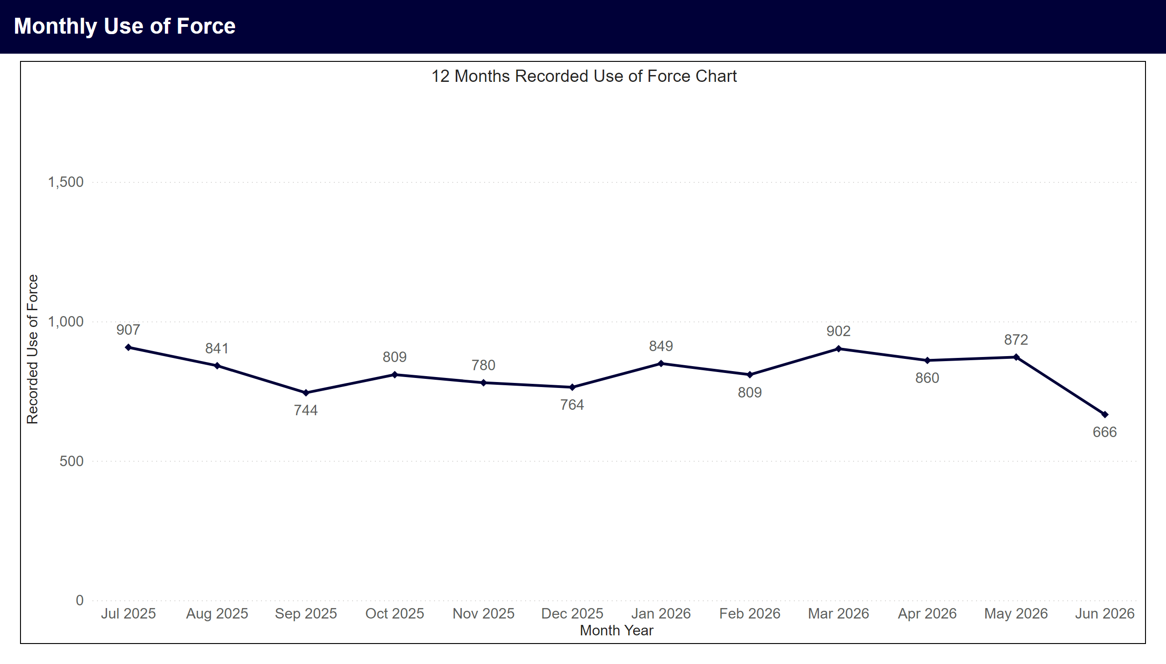
Monthly Use of Force
Notes:
12 Months Recorded Use of Force Chart
Line chart showing monthly use of force records for the last 12 calendar months. An average of 817 records were recorded per month. Highest months were Jul 2025 with 907, Mar 2026 with 902, May 2026 with 872.

Slide 3
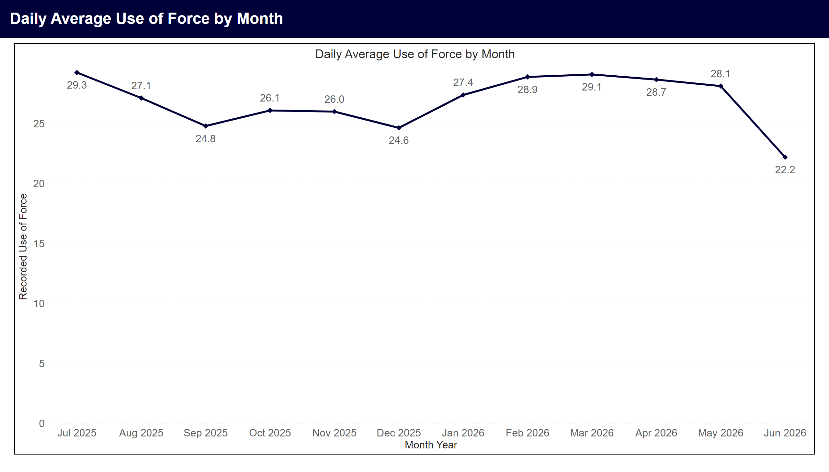
Daily Averages by Month
Notes:
Daily Average Use of Force by Month
Line chart showing average daily use of force records by month. Highest months in period were Jul 2025 with 29.3, Mar 2026 with 29.1, Feb 2026 with 28.9.

Slide 4
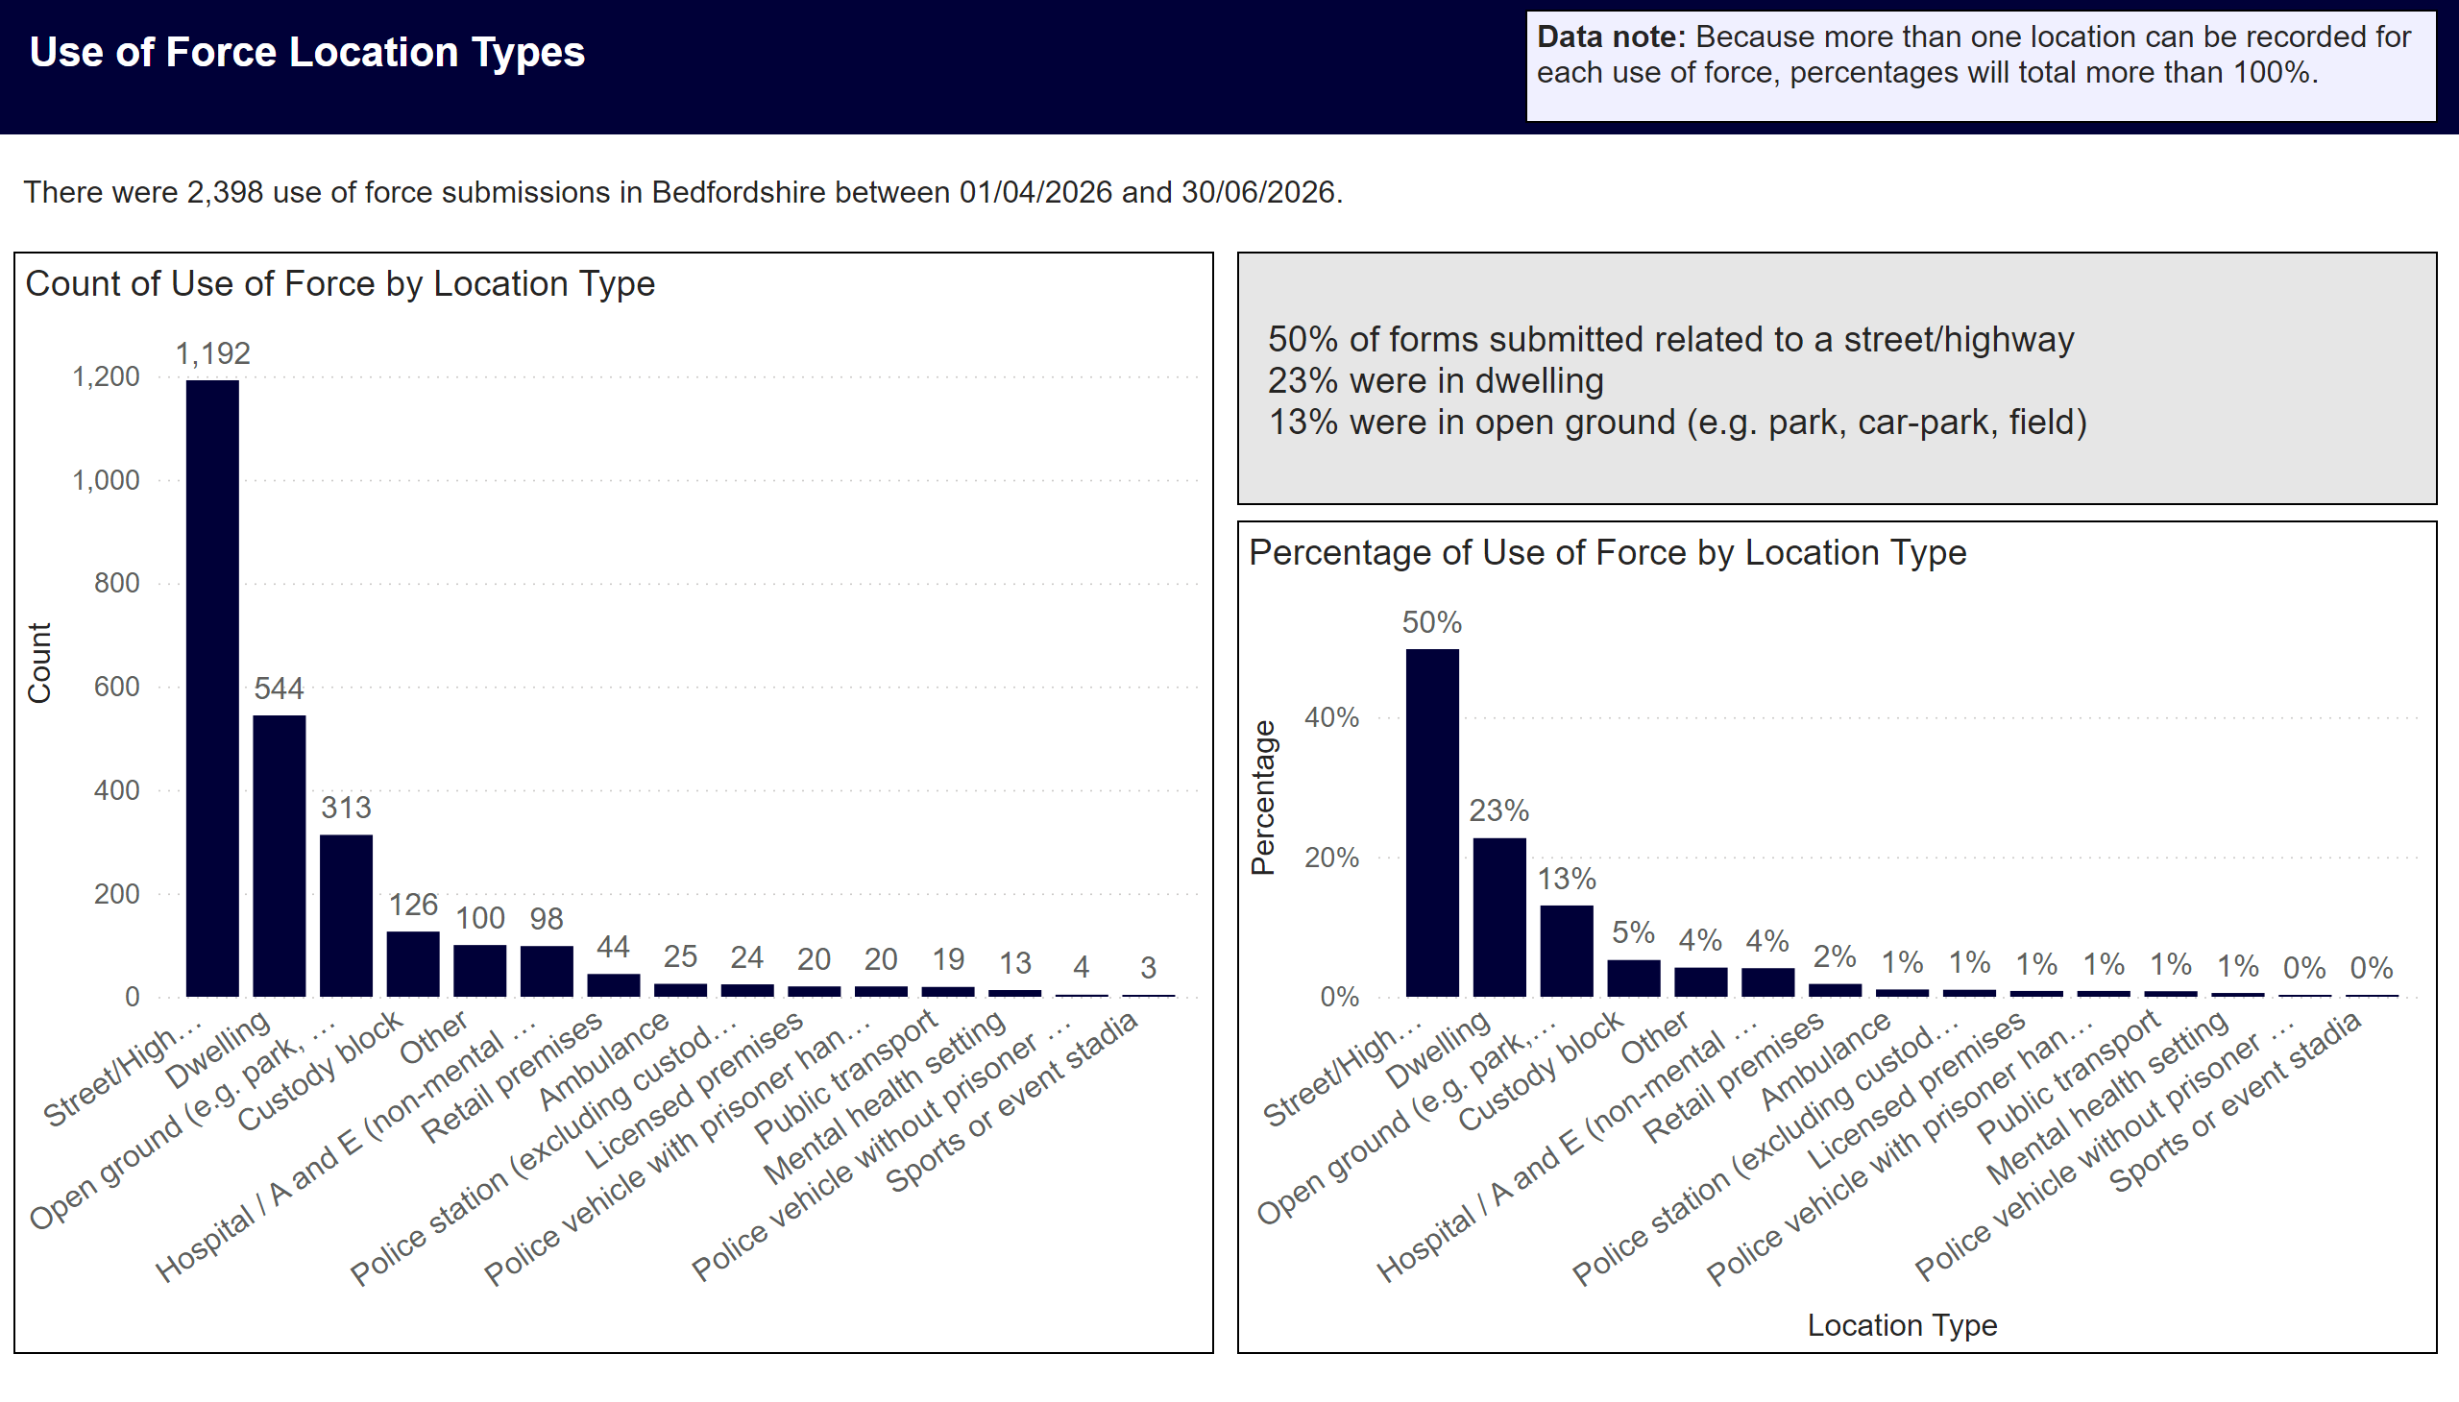
Location Type
Notes:
Data Note
Data note: Because more than one location can be recorded for each use of force, percentages will total more than 100%.
Overview
There were 2,398 use of force submissions in Bedfordshire between 01/04/2026 and 30/06/2026.
Top Three locations by percentage
50% of forms submitted related to a street/highway
23% were in dwelling
13% were in open ground (e.g. park, car-park, field)
Use of Force by Location Type
The top five use of force locations in the period were street/highway with 1,192 (50%), dwelling with 544 (23%), open ground (e.g. park, car-park, field) with 313 (13%), custody block with 126 (5%), other with 100 (4%).

Slide 5
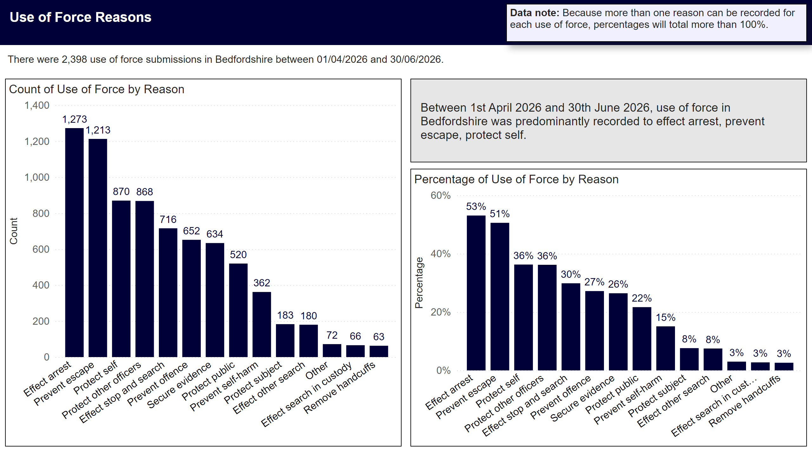
Reason
Notes:
Data Note
Data note: Because more than one reason can be recorded for each use of force, percentages will total more than 100%.
Overview
There were 2,398 use of force submissions in Bedfordshire between 01/04/2026 and 30/06/2026.
Top Reasons for Use of Force in Period
Between 1st April 2026 and 30th June 2026, use of force in Bedfordshire was predominantly recorded to effect arrest 1273 (53%), prevent escape 1213 (51%), protect self 870 (36%).

Slide 6
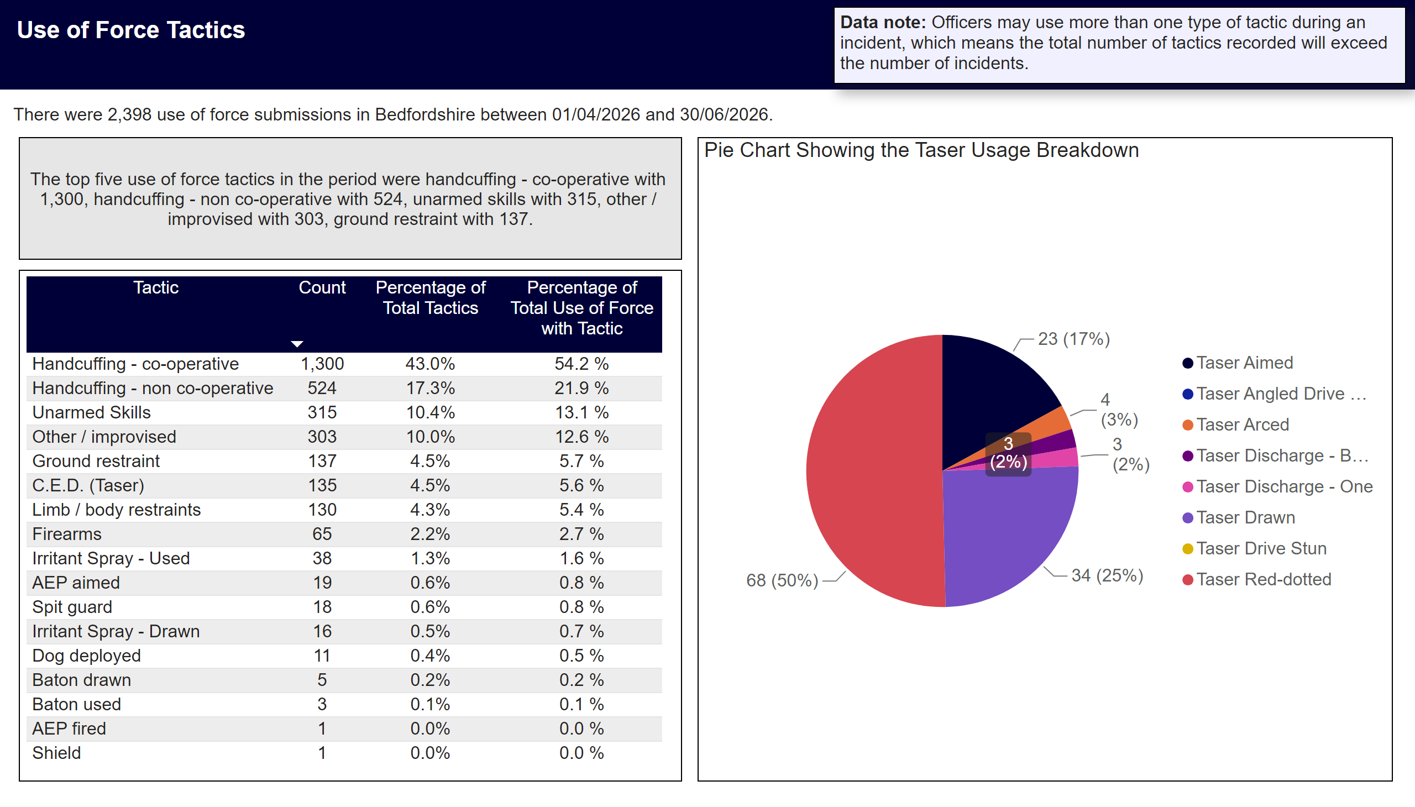
Tactics Used
Notes:
Title
Use of Force Tactics
Data Note
Data note: Officers may use more than one type of tactic during an incident, which means the total number of tactics recorded will exceed the number of incidents.
Overview
There were 2,398 use of force submissions in Bedfordshire between 01/04/2026 and 30/06/2026.
Table
Table showing count of use of force by tactic used. Percentage of total tactics, and percentage of total use of force with tactic.
Top 5 Tactics Used
The top five use of force tactics in the period were handcuffing - co-operative with 1,300, handcuffing - non co-operative with 524, unarmed skills with 315, other / improvised with 303, ground restraint with 137.
Pie Chart Showing the Taser Usage Breakdown
Tasers were used in 135 instances of use of force in the period. 68 red-dotted, 23 aimed, 34 drawn, 0 angled drive stun, 4 arced, 6 discharged, 0 drive stun.

Slide 7
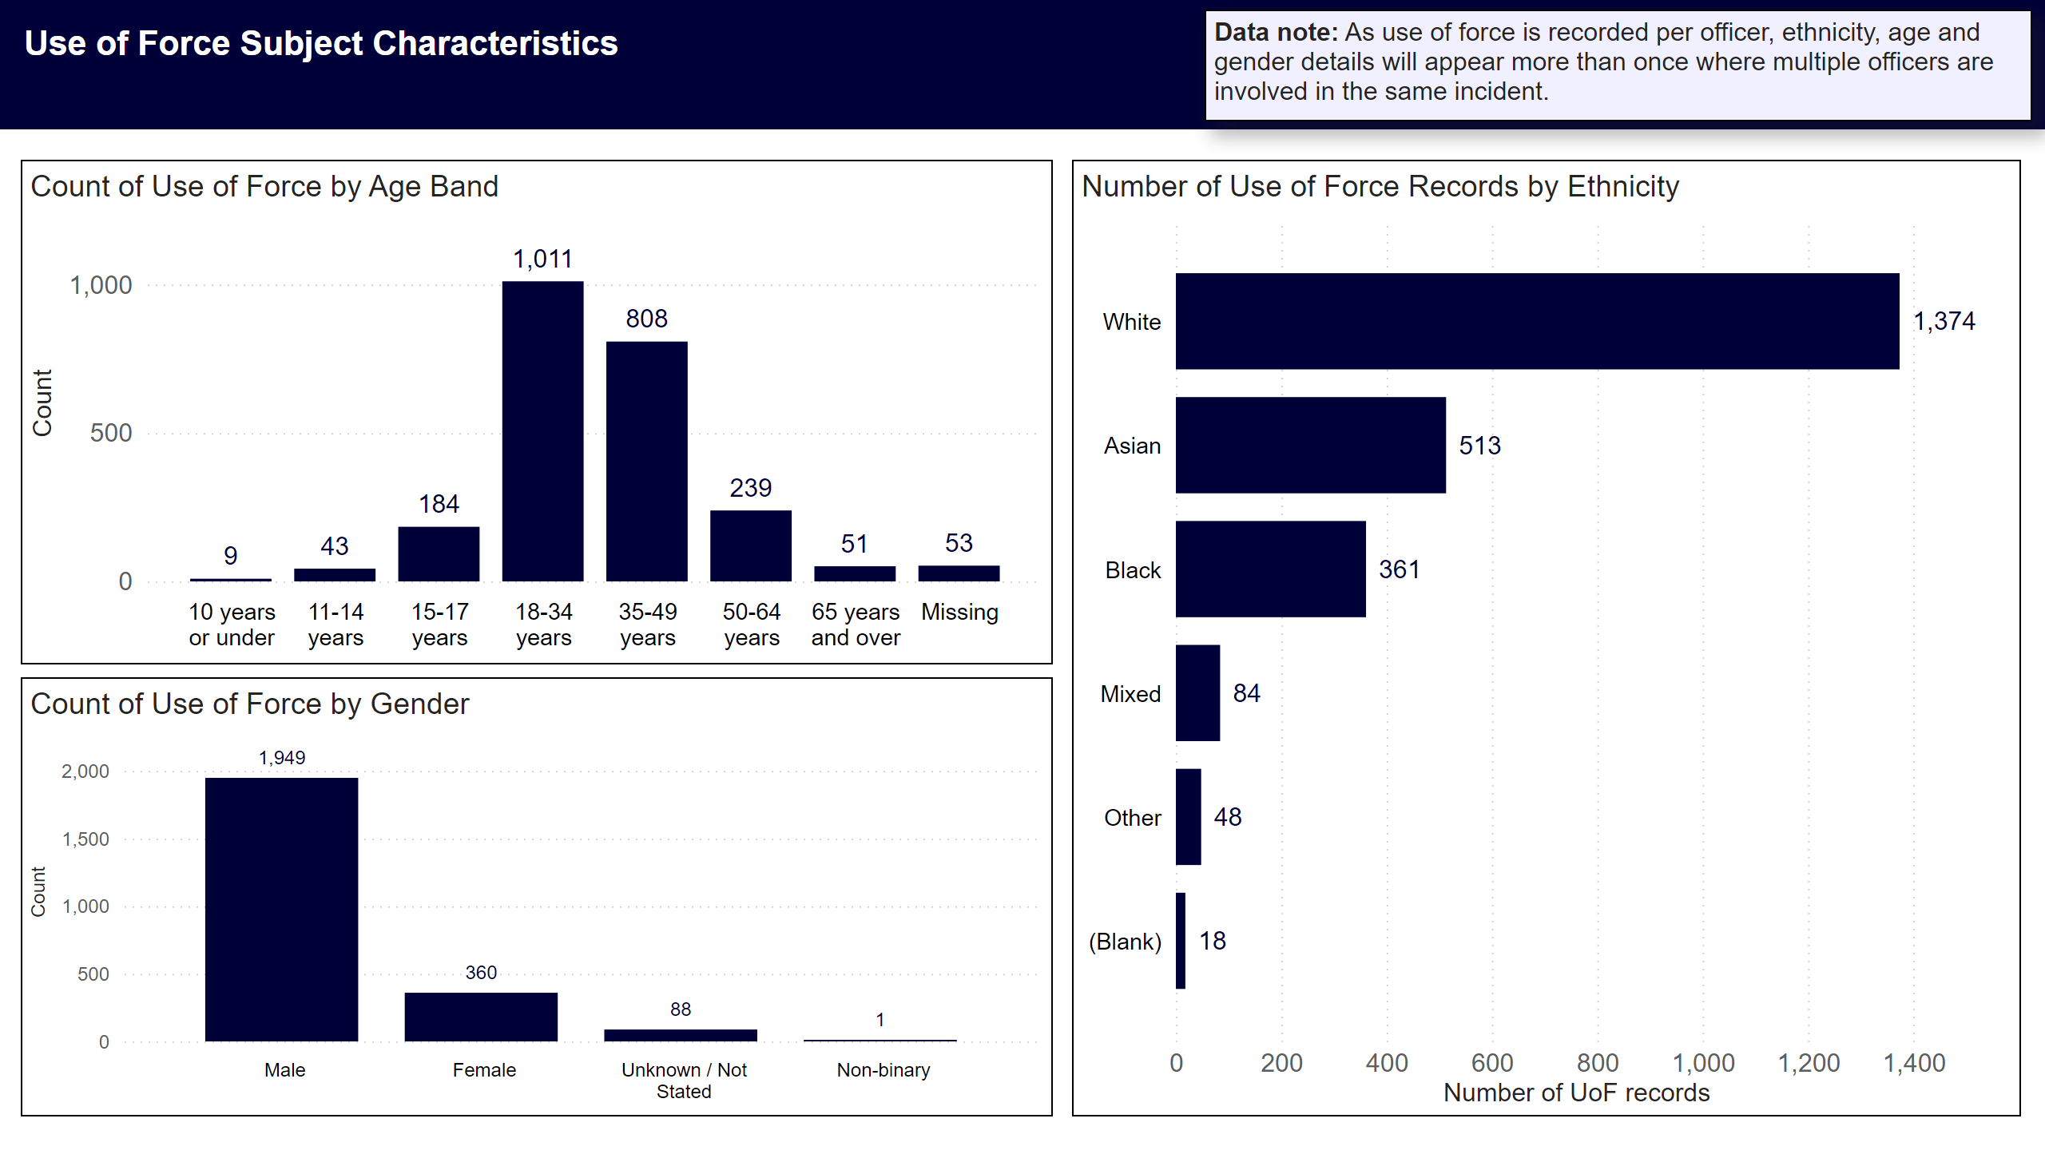
Subject Characteristics - Counts
Notes:
Title
Use of Force Subject Characteristics
Data Note
Data note: As use of force is recorded per officer, ethnicity, age and gender details will appear more than once where multiple officers are involved in the same incident.
Number of Use of Force Records by Ethnicity
Ethnicity breakdown was as follows White with 1,374, Asian with 513, Black with 361, Mixed with 84, Other with 48.
Count of Use of Force by Age Band
Top three age bands were18-34 years with 1,011, 35-49 years with 808, 50-64 years with 239.
Count of Use of Force by Gender
Gender breakdown male 1,949, female 360.

Slide 8
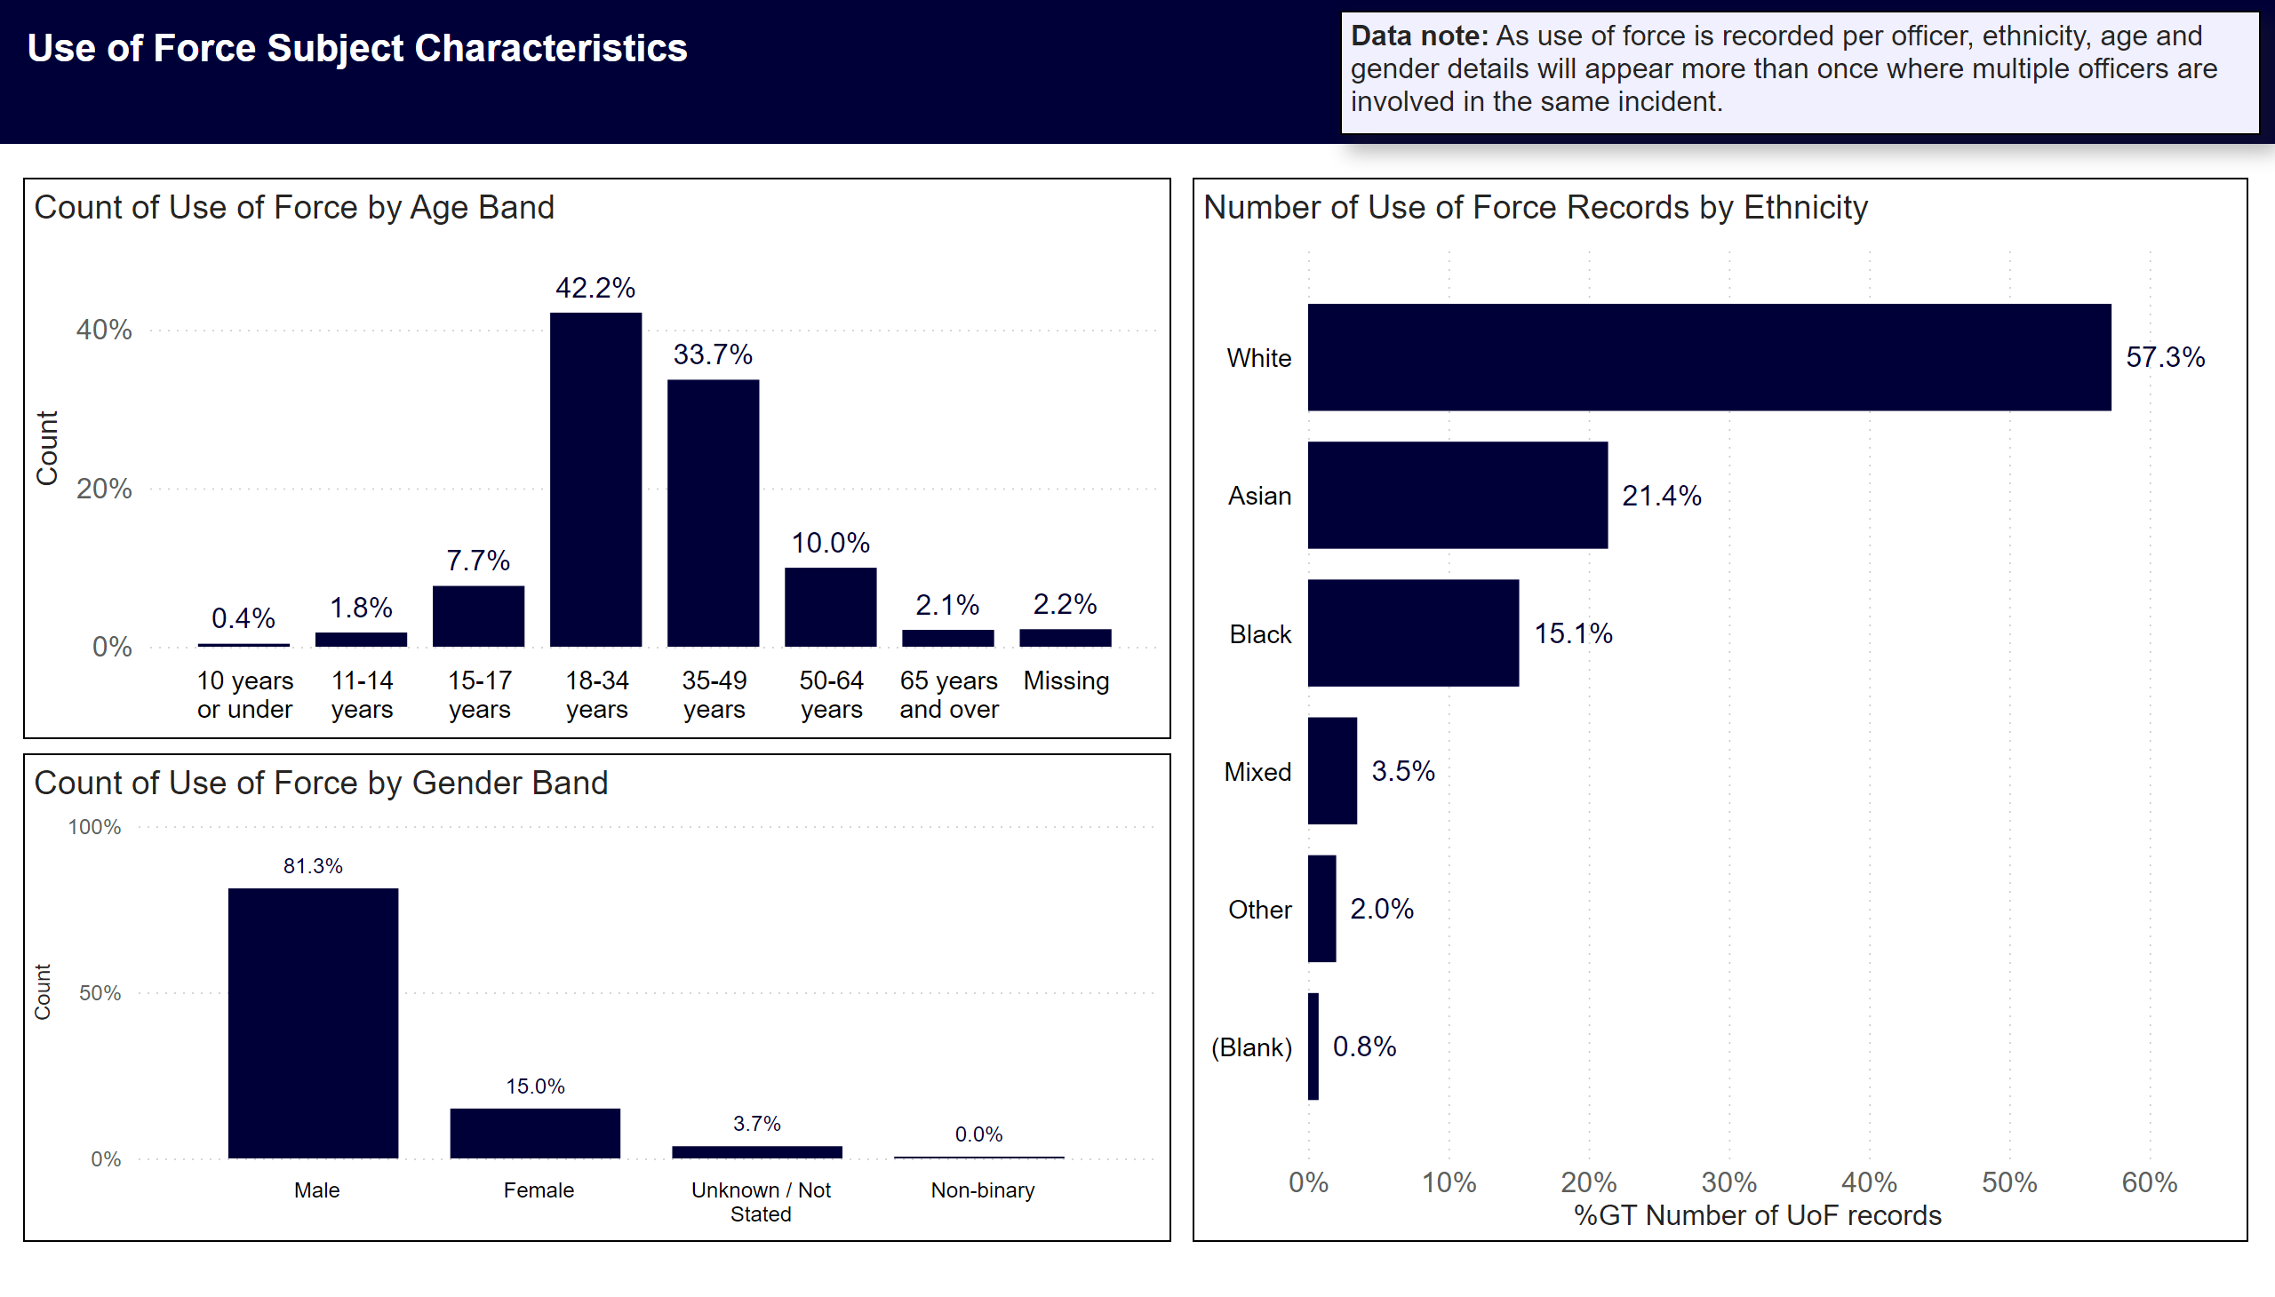
Subject Characteristics - Percentages
Notes:
Title
Use of Force Subject Characteristics
Data Note
Data note: As use of force is recorded per officer, ethnicity, age and gender details will appear more than once where multiple officers are involved in the same incident.
Count of Use of Force by Age Band
42% of forms submitted related to persons aged 18-34 years
34% were 35-49 years
10% were 50-64 years
Count of Use of Force by Gender Band
81% of use of force subjects were male
15% were female
Number of Use of Force Records by Ethnicity
57% of subjects were White
21% were Asian
15% were Black
4% were Mixed
2% were Other

