Slide 1
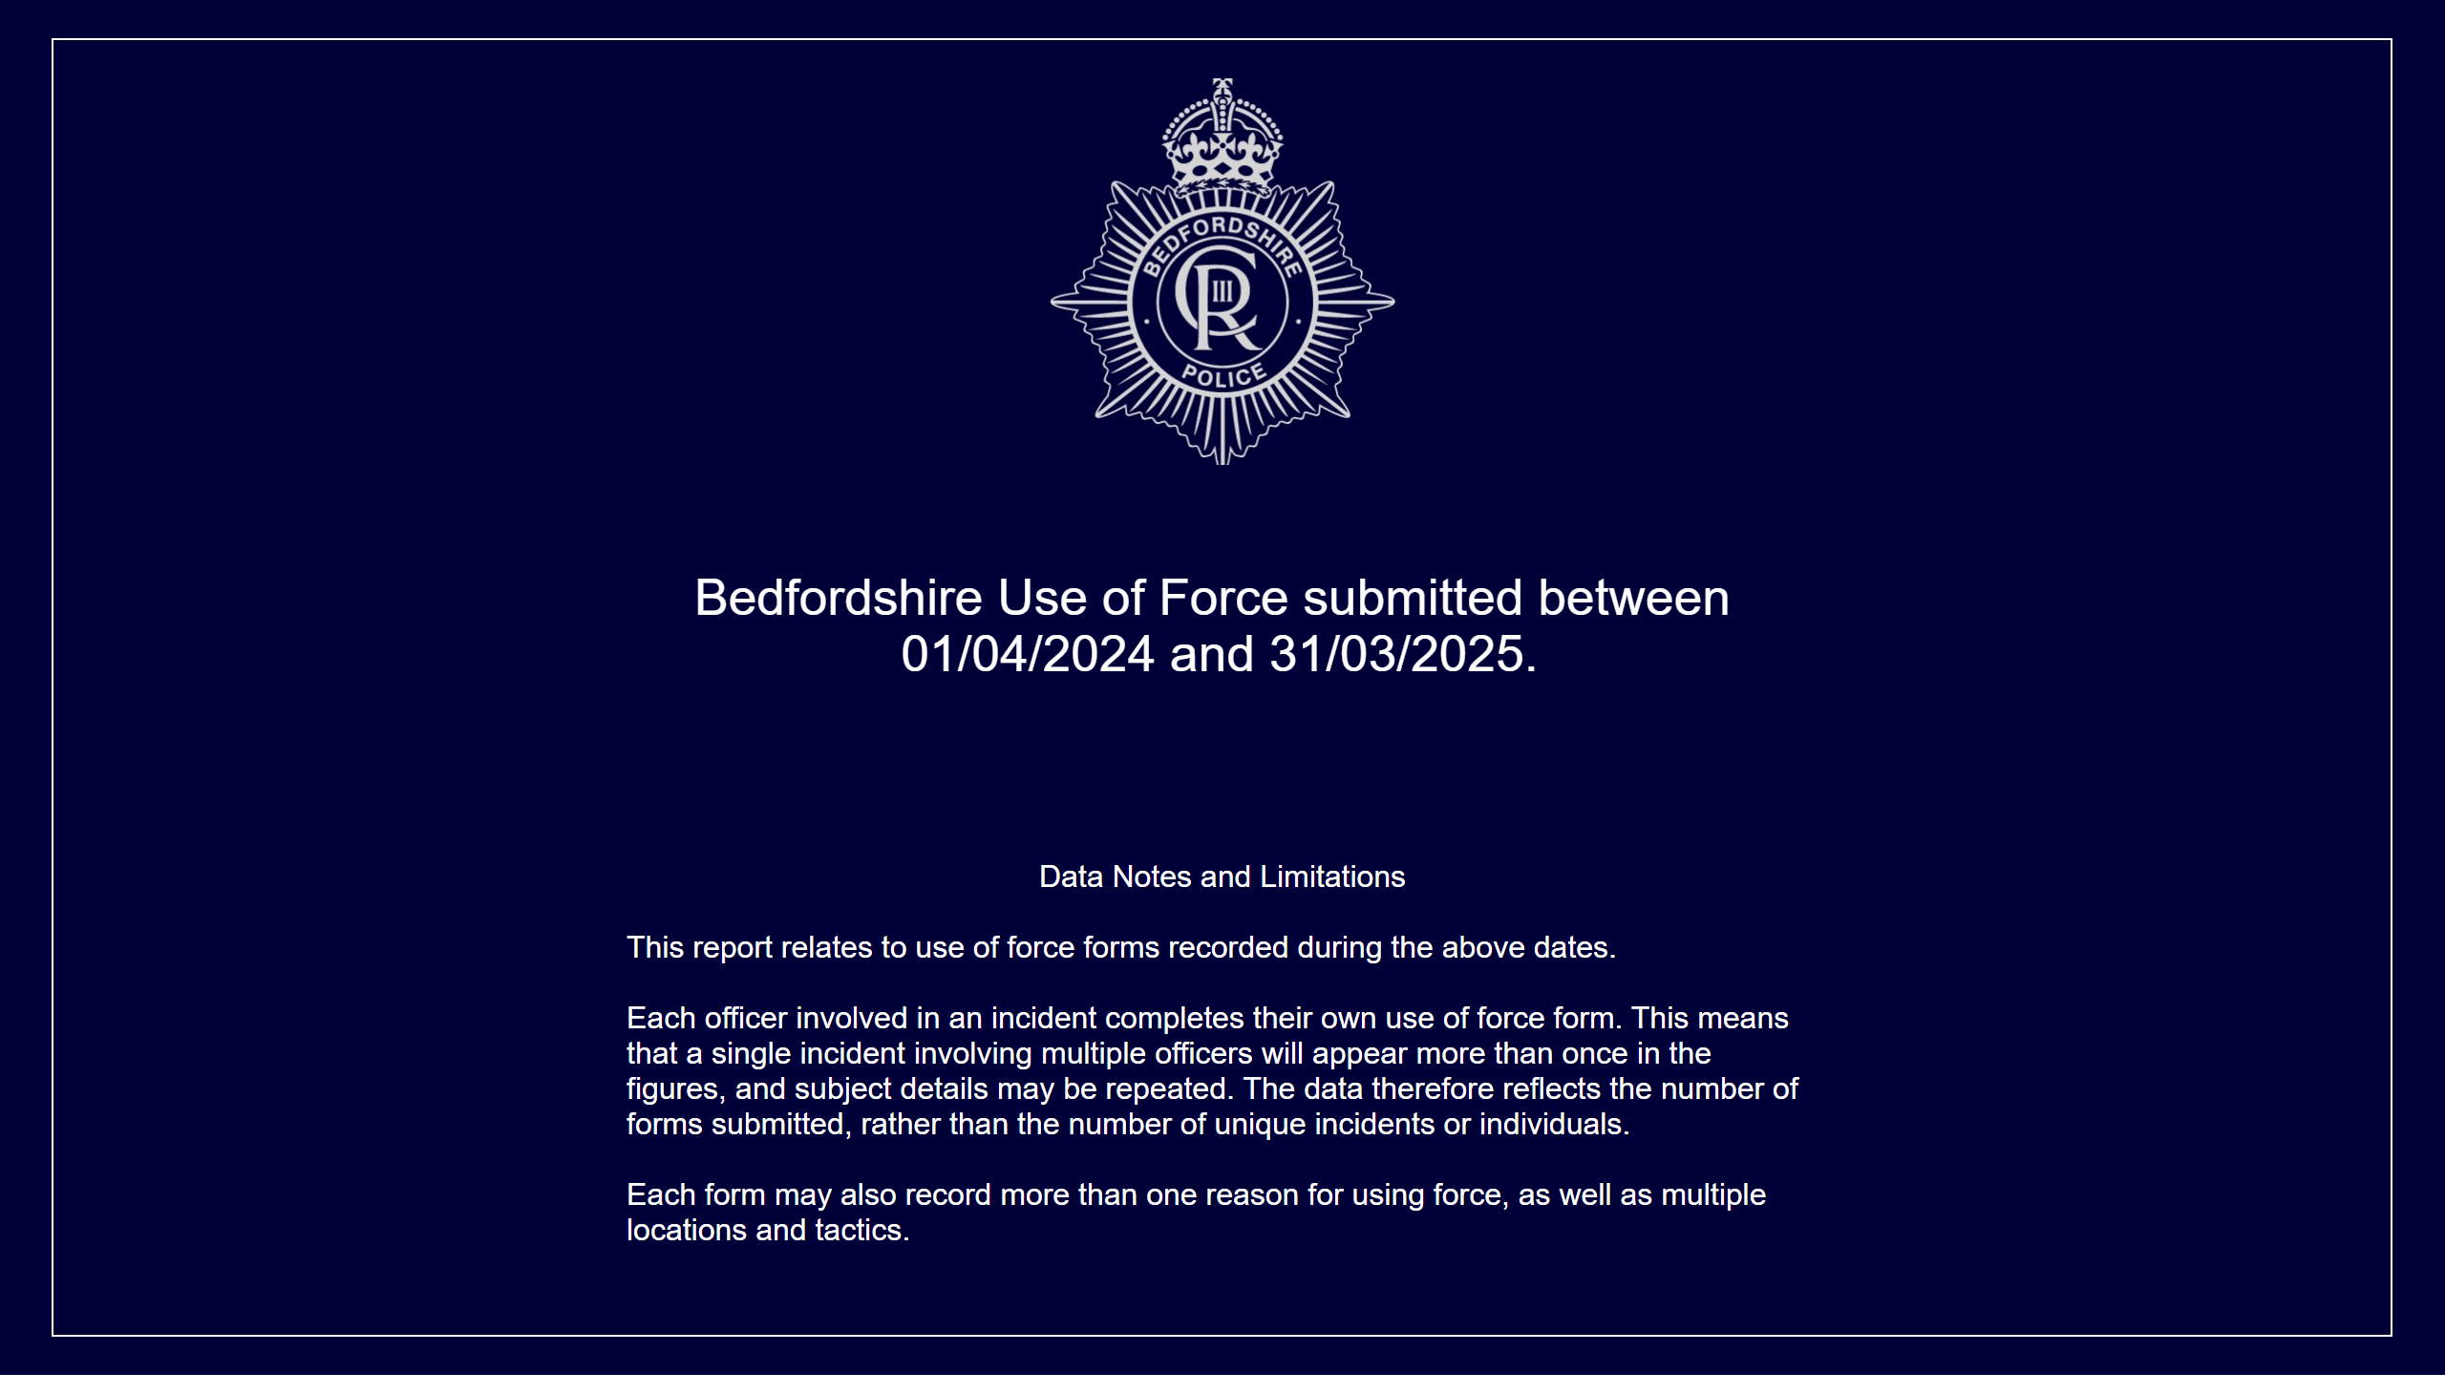
Front Page
Notes:
Data Notes and Limitations
Data notes and limitations
This report relates to use of force forms recorded during the above dates.
Each officer involved in an incident completes their own use of force form. This means that a single incident involving multiple officers will appear more than once in the figures, and subject details may be repeated. The data therefore reflects the number of forms submitted, rather than the number of unique incidents or individuals.
Each form may also record more than one reason for using force, as well as multiple locations and tactics.
Period Selected
Bedfordshire Use of Force submitted between 01/04/2024 and 31/03/2025.

Slide 2
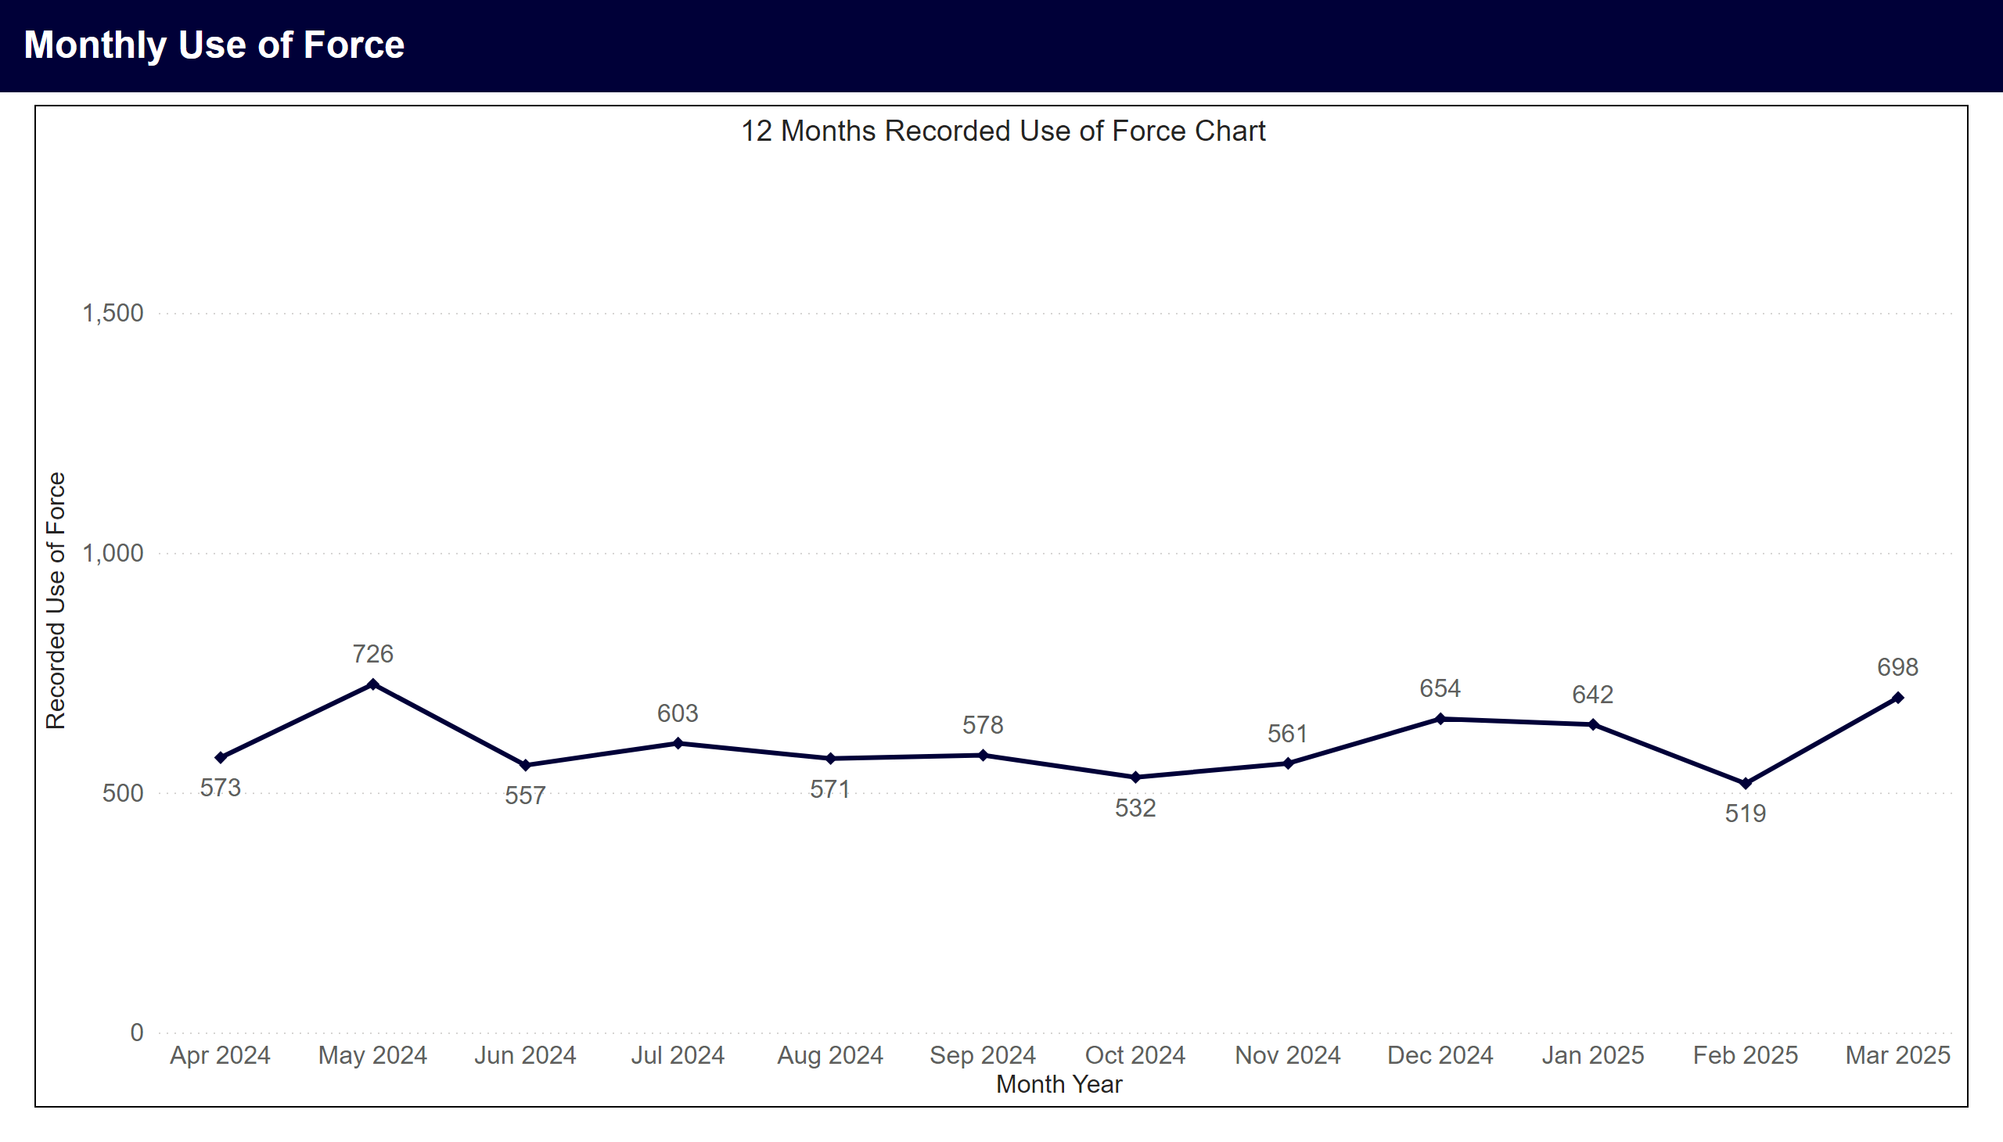
Monthly Use of Force
Notes:
12 Months Recorded Use of Force Chart
Line chart showing monthly use of force records for the last 12 calendar months. An average of 601 records were recorded per month. Highest months were May 2024 with 726, Mar 2025 with 698, Dec 2024 with 654.

Slide 3
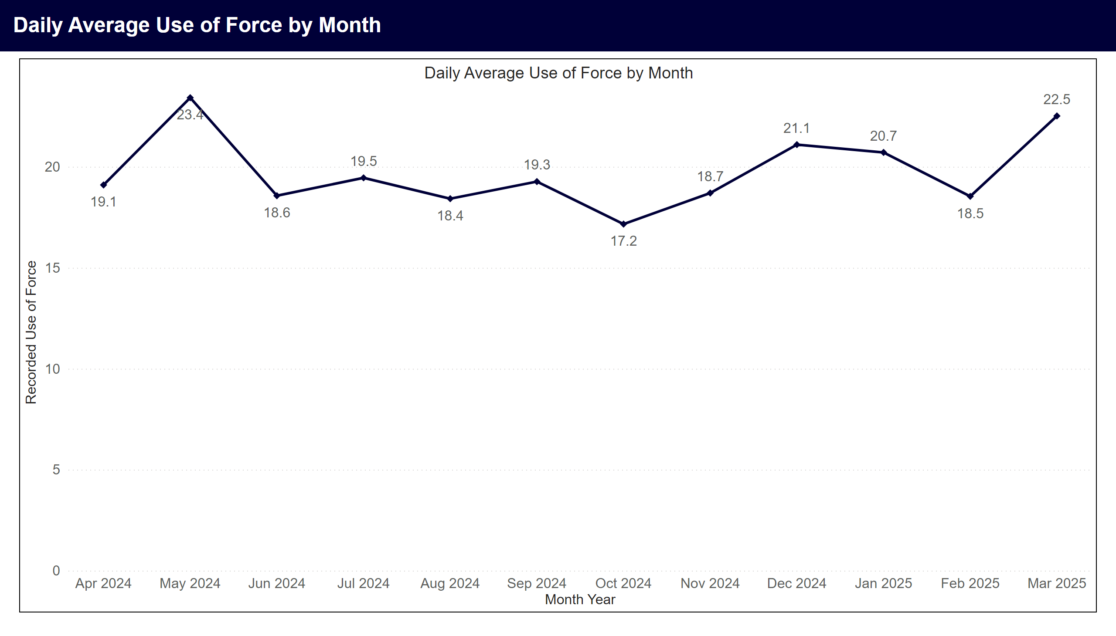
Daily Averages by Month
Notes:
Daily Average Use of Force by Month
Line chart showing average daily use of force records by month. Highest months in period were May 2024 with 23.4, Mar 2025 with 22.5, Dec 2024 with 21.1.

Slide 4
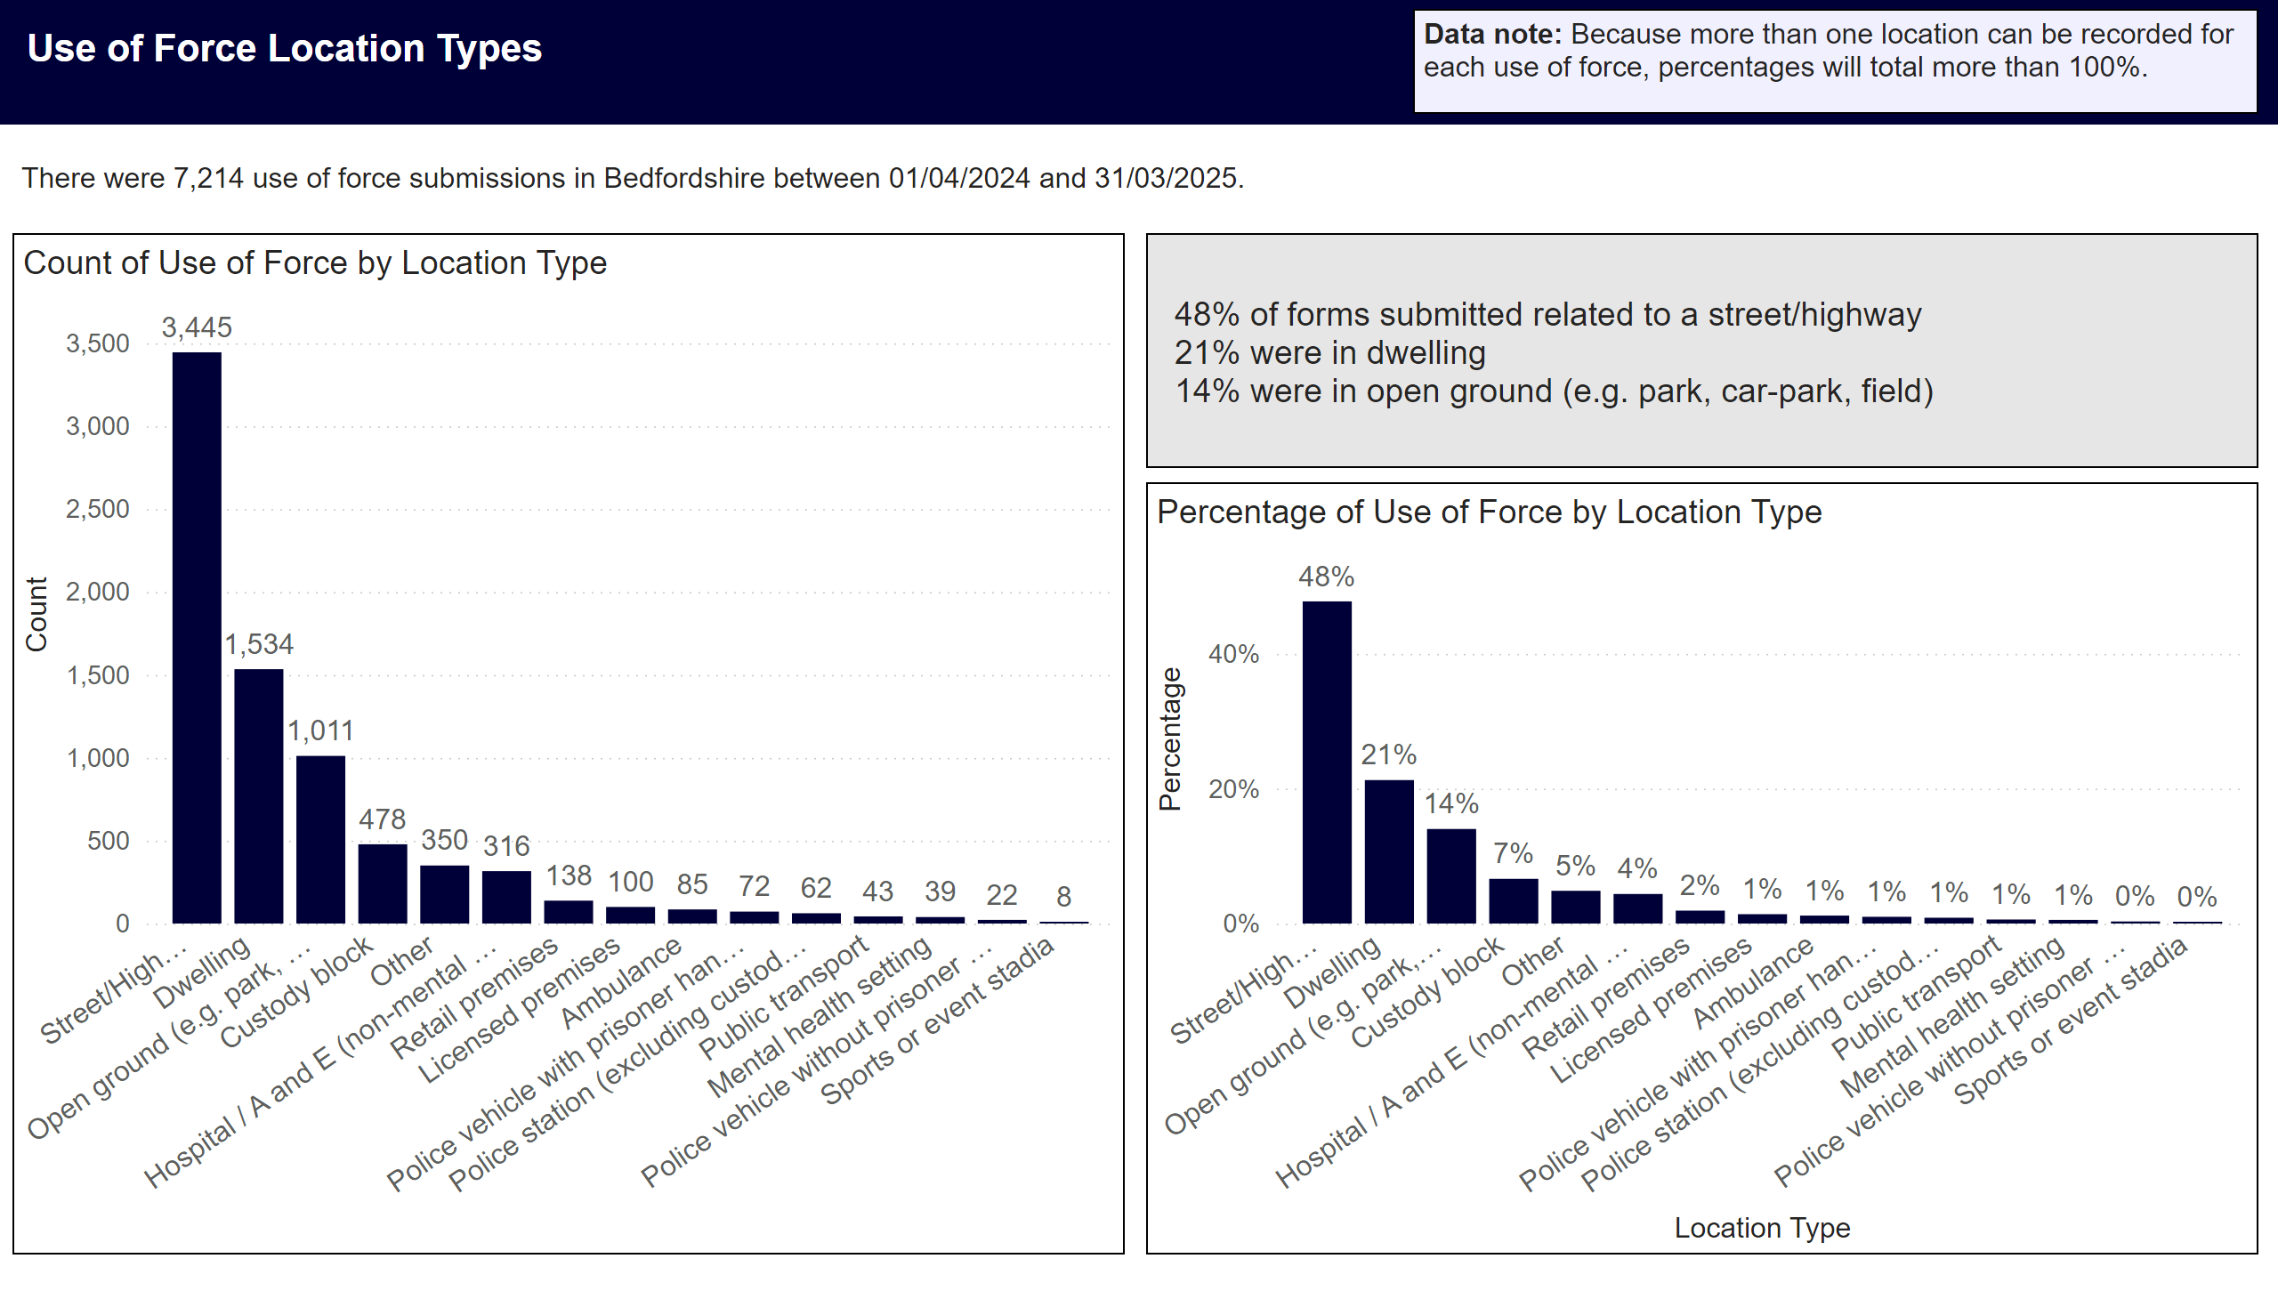
Location Type
Notes:
Data Note
Data note: Because more than one location can be recorded for each use of force, percentages will total more than 100%.
Overview
There were 7,214 use of force submissions in Bedfordshire between 01/04/2024 and 31/03/2025.
Top Three locations by percentage
48% of forms submitted related to a street/highway
21% were in dwelling
14% were in open ground (e.g. park, car-park, field)
Count of Use of Force by Location Type
The top five use of force locations in the period were street/highway with 3,445, dwelling with 1,534, open ground (e.g. park, car-park, field) with 1,011, custody block with 478, other with 350.
Percentage of Use of Force by Location Type
Bar chart showing percentage of use of force by location type. 48% were Street/Highway, 21% Dwelling and 14% open ground (e.g. park, car-park, field).

Slide 5
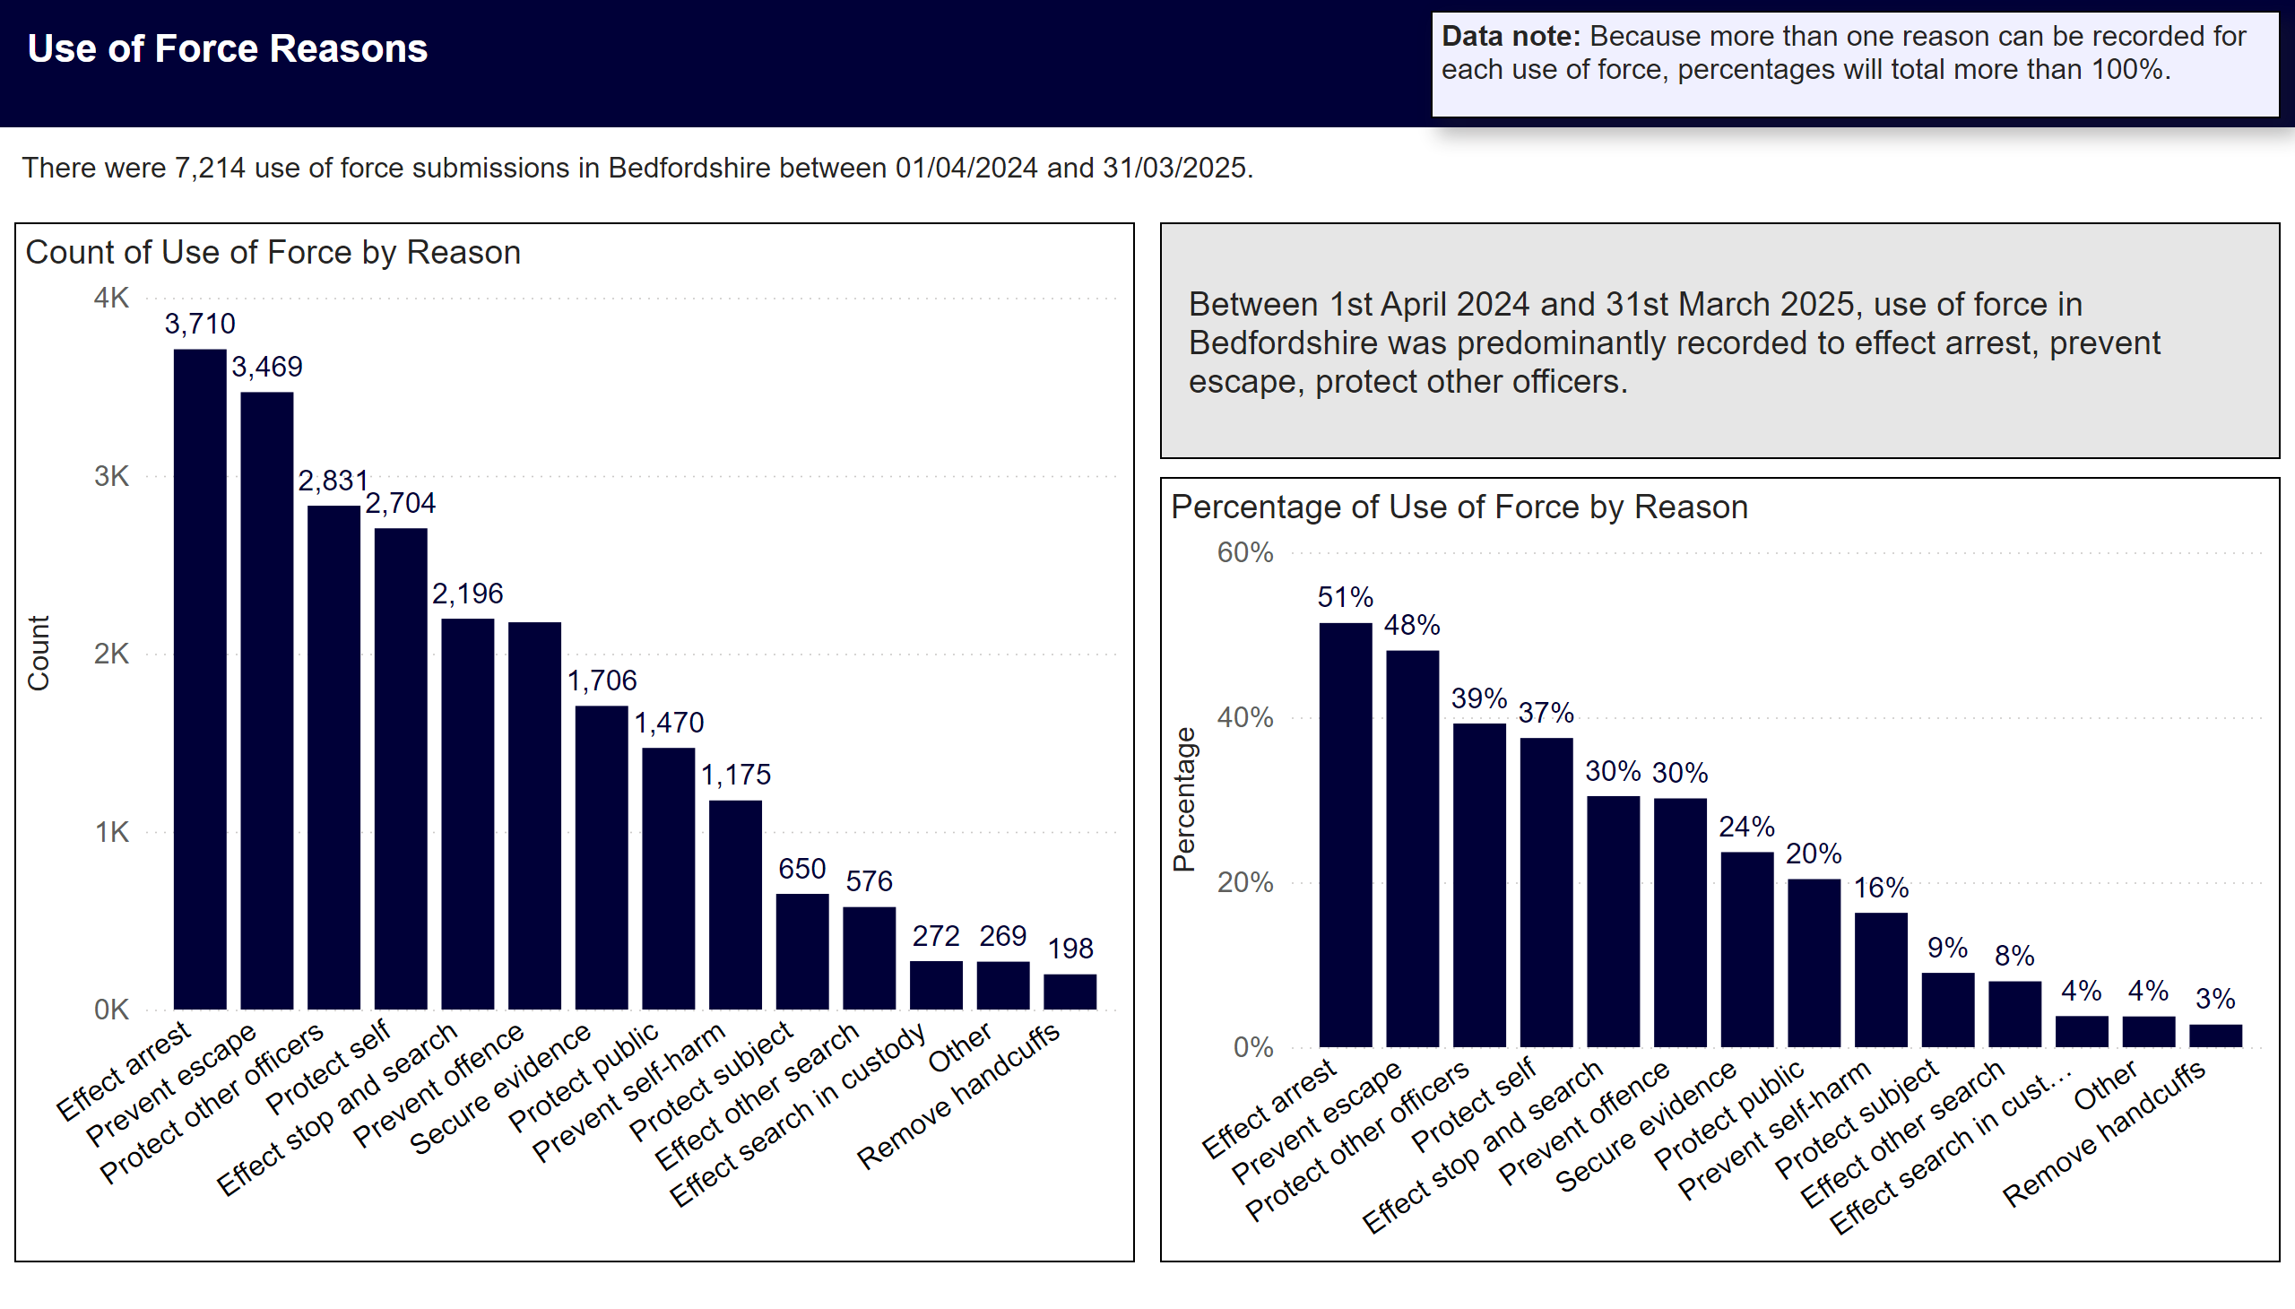
Reason
Notes:
Data Note
Data note: Because more than one reason can be recorded for each use of force, percentages will total more than 100%.
Overview
There were 7,214 use of force submissions in Bedfordshire between 01/04/2024 and 31/03/2025.
Top Reasons for Use of Force in Period
Between 1st April 2024 and 31st March 2025, use of force in Bedfordshire was predominantly recorded to effect arrest, prevent escape, protect other officers.
Use of Force by Reason
Bar charts showing percentage of use of force by reason. 51% (3710) were to effect arrest. 48% (3469) were to prevent escape. 39% (2831) were to protect other officers.

Slide 6
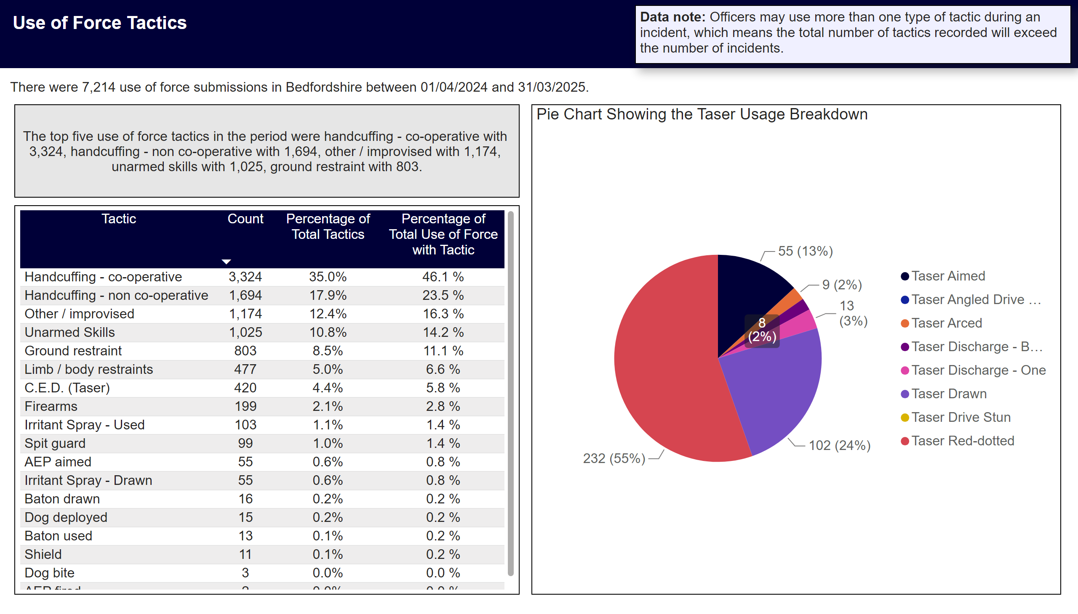
Tactics Used
Notes:
Title
Use of Force Tactics
Data Note
Data note: Officers may use more than one type of tactic during an incident, which means the total number of tactics recorded will exceed the number of incidents.
Table showing count of use of force by tactic used. Percentage of total tactics, and percentage of total use of force with tactic.
Overview
There were 7,214 use of force submissions in Bedfordshire between 01/04/2024 and 31/03/2025.
Top 5 Tactics Used
The top five use of force tactics in the period were handcuffing - co-operative with 3,324, handcuffing - non co-operative with 1,694, other / improvised with 1,174, unarmed skills with 1,025, ground restraint with 803.
Pie Chart Showing the Taser Usage Breakdown
Tasers were used in 420 instances of use of force in the period. 232 red-dotted, 55 aimed, 102 drawn, 0 angled drive stun, 9 arced, 21 discharged, 0 drive stun.

Slide 7
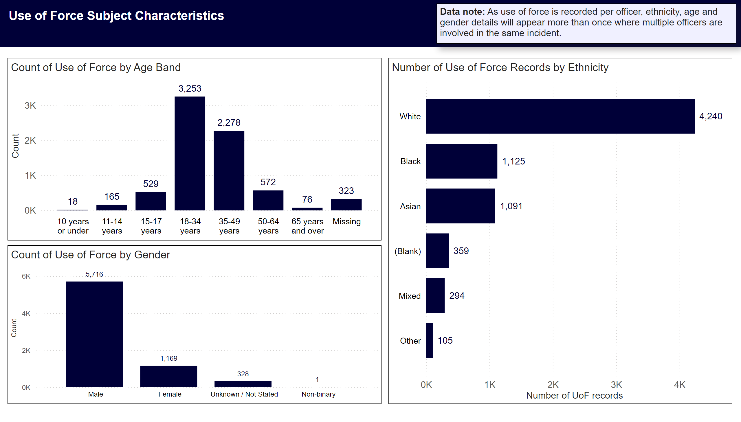
Subject Characteristics - Counts
Notes:
Title
Use of Force Subject Characteristics
Data Note
Data note: As use of force is recorded per officer, ethnicity, age and gender details will appear more than once where multiple officers are involved in the same incident.
Number of Use of Force Records by Ethnicity
Ethnicity breakdown was as follows White with 4,240, Black with 1,125, Asian with 1,091, with 359, Mixed with 294.
Count of Use of Force by Age Band
Top three age bands were18-34 years with 3,253, 35-49 years with 2,278, 50-64 years with 572.
Count of Use of Force by Gender
Gender breakdown male 5,716, female 1,169.

Slide 8

Subject Characteristics - Percentages
Notes:
Title
Use of Force Subject Characteristics
Data Note
Data note: As use of force is recorded per officer, ethnicity, age and gender details will appear more than once where multiple officers are involved in the same incident.
Count of Use of Force by Age Band
45% of forms submitted related to persons aged 18-34 years
32% were 35-49 years
8% were 50-64 years
Count of Use of Force by Gender Band
79% of use of force subjects were male
16% were female
Number of Use of Force Records by Ethnicity
59% of subjects were White
16% were Black
15% were Asian
5% were
4% were Mixed

