Slide 1
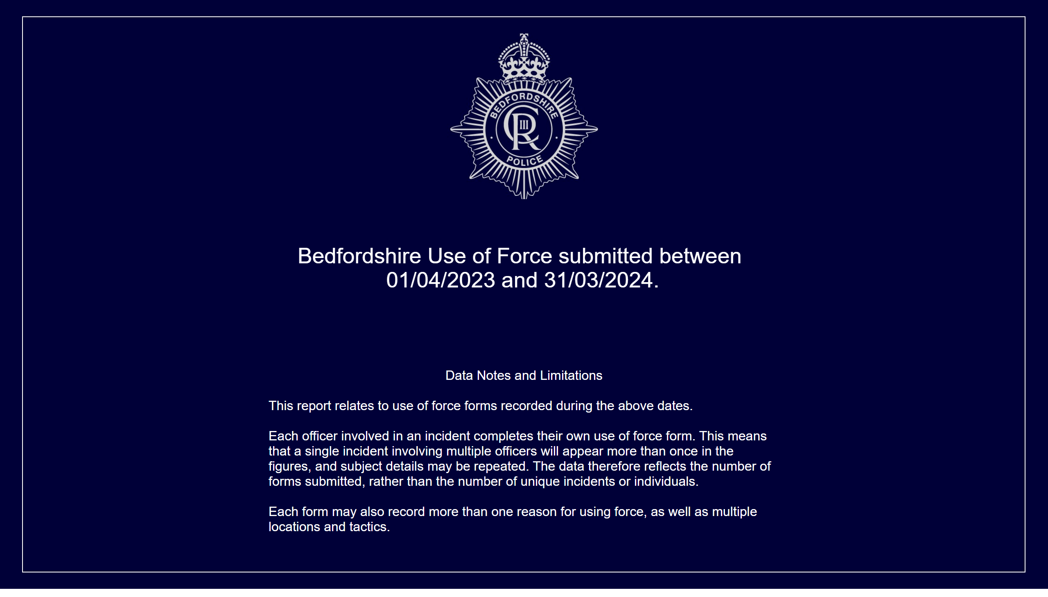
Front Page
Notes:
Data Notes and Limitations
Period Selected
Bedfordshire Use of Force submitted between 01/04/2023 and 31/03/2024.
This report relates to use of force forms recorded during the above dates.
Each officer involved in an incident completes their own use of force form. This means that a single incident involving multiple officers will appear more than once in the figures, and subject details may be repeated. The data therefore reflects the number of forms submitted, rather than the number of unique incidents or individuals.
Each form may also record more than one reason for using force, as well as multiple locations and tactics.

Slide 2
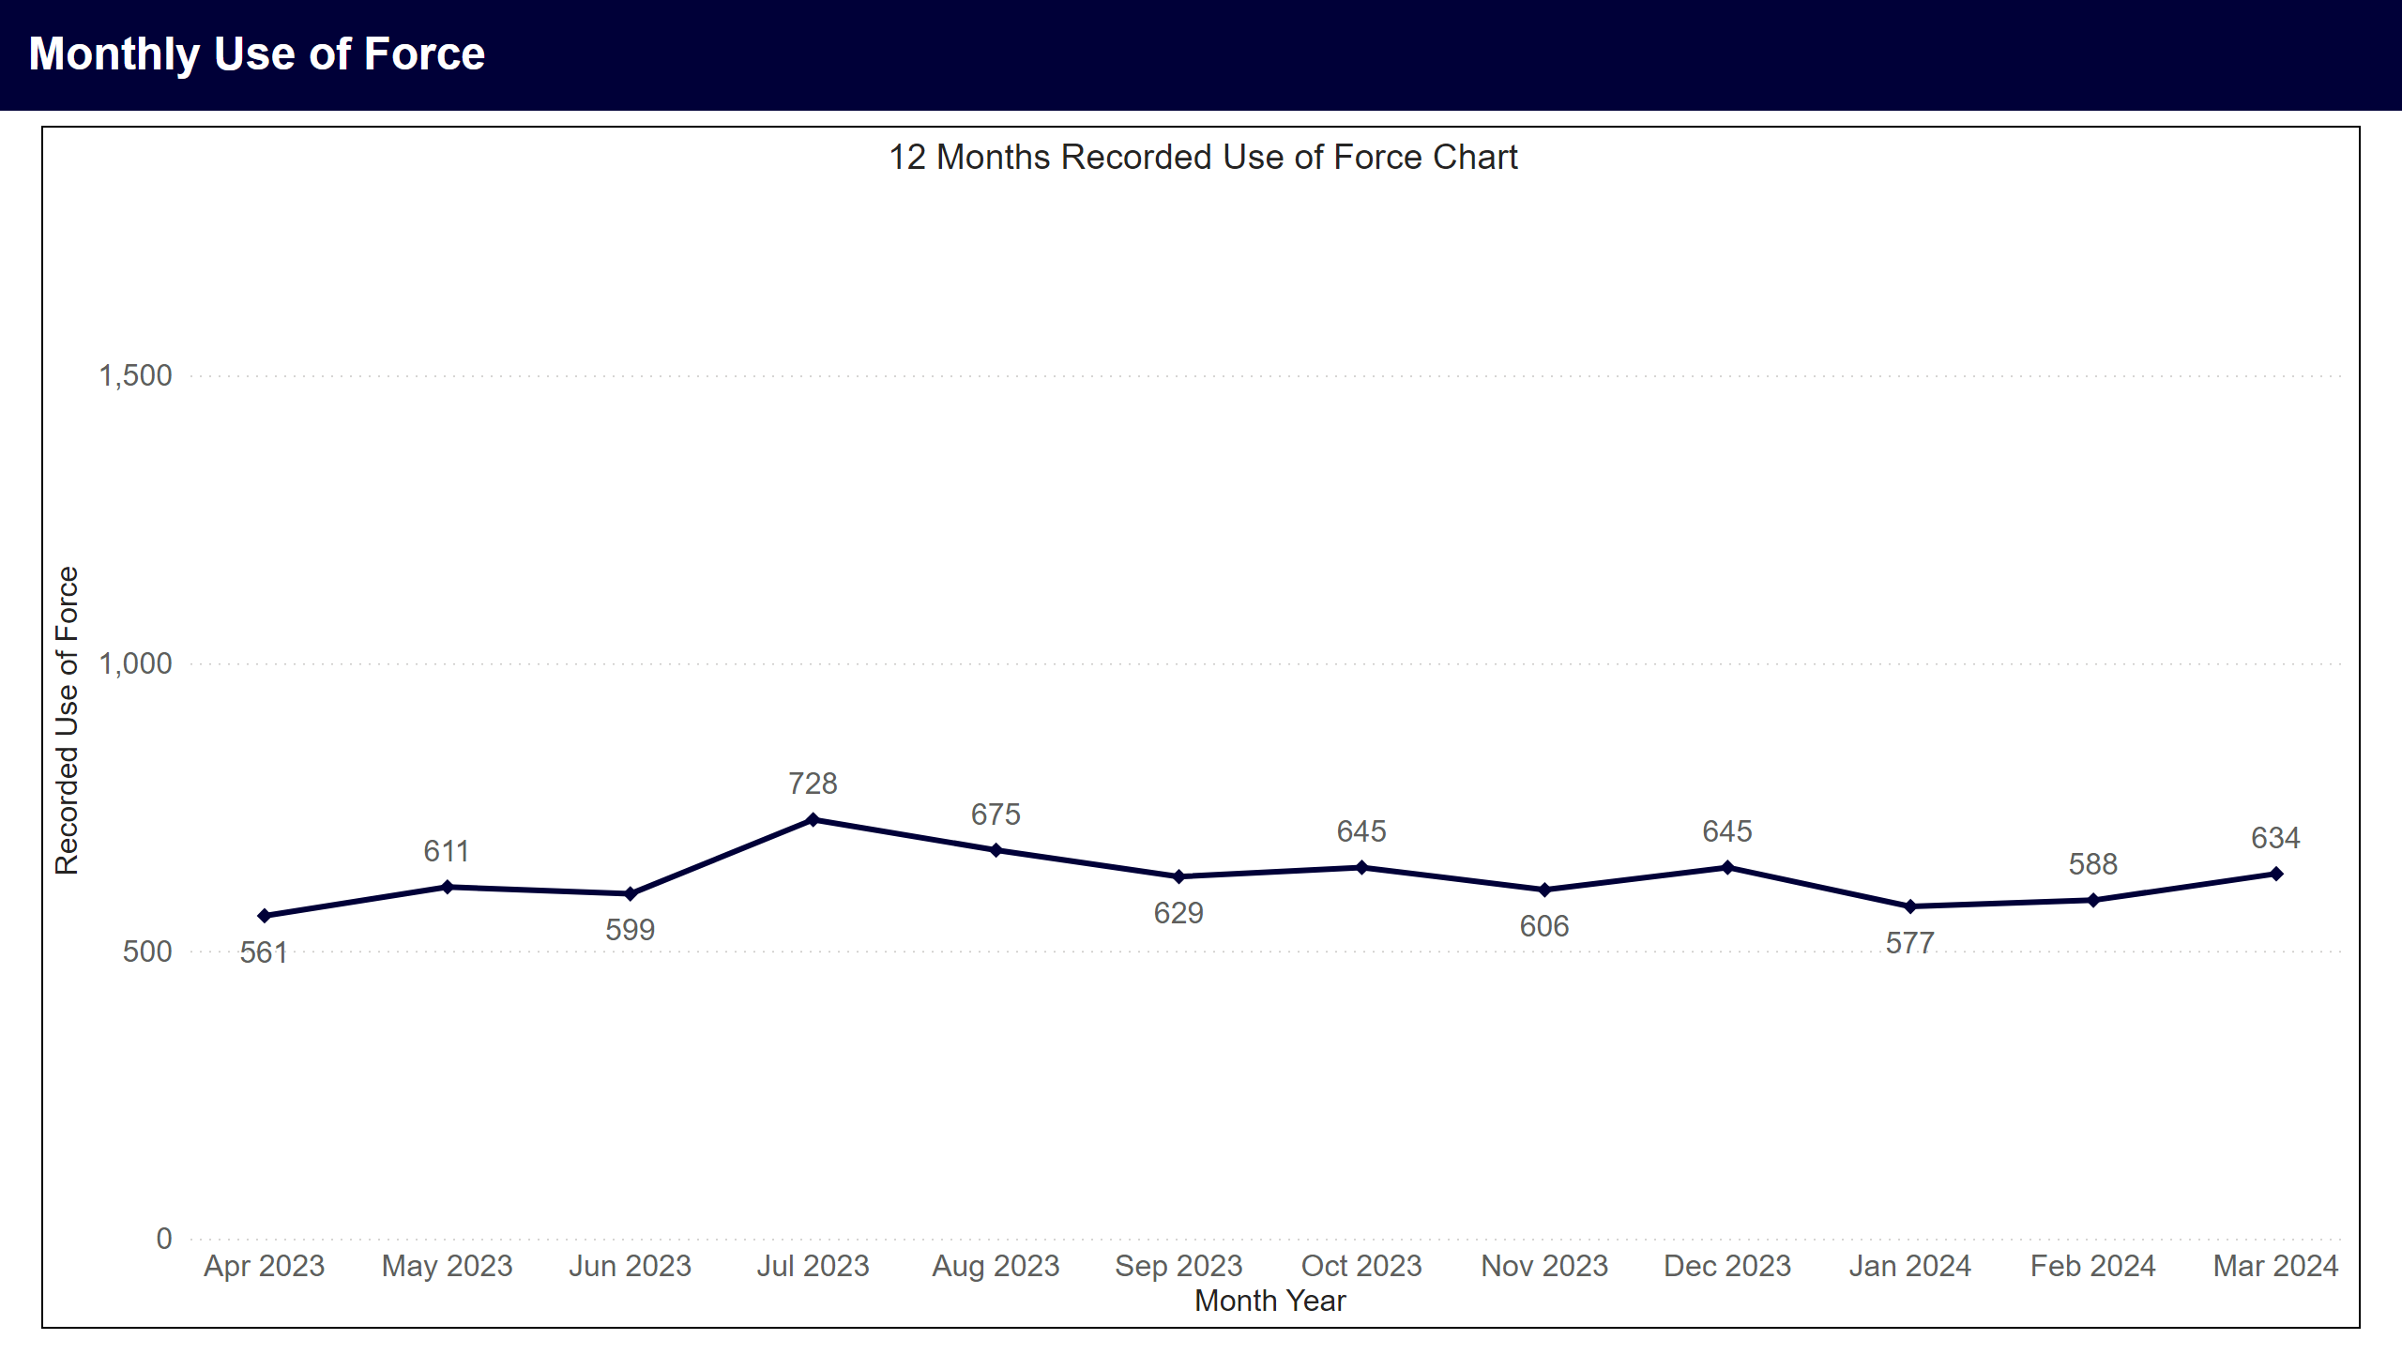
Monthly Use of Force
Notes:
12 Months Recorded Use of Force Chart
Line chart showing monthly use of force records for the last 12 calendar months. An average of 625 records were recorded per month. Highest months were Jul 2023 with 728, Aug 2023 with 675, Oct 2023 with 645, Dec 2023 with 645.

Slide 3
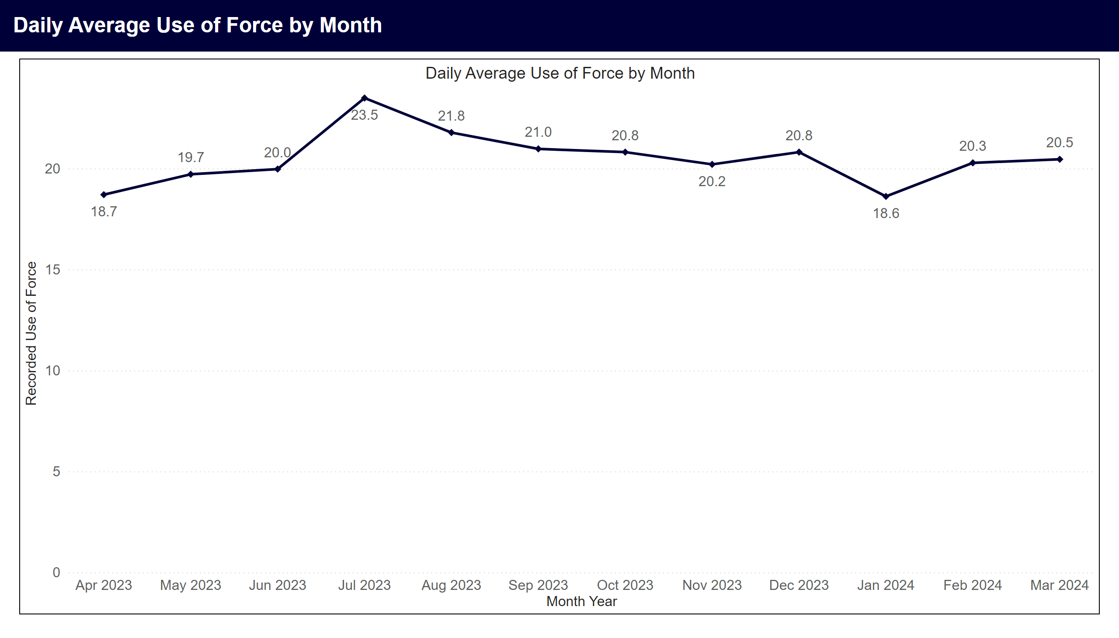
Daily Averages by Month
Notes:
Daily Average Use of Force by Month
Line chart showing average daily use of force records by month. Highest months in period were Jul 2023 with 23.5, Aug 2023 with 21.8, Sep 2023 with 21.

Slide 4
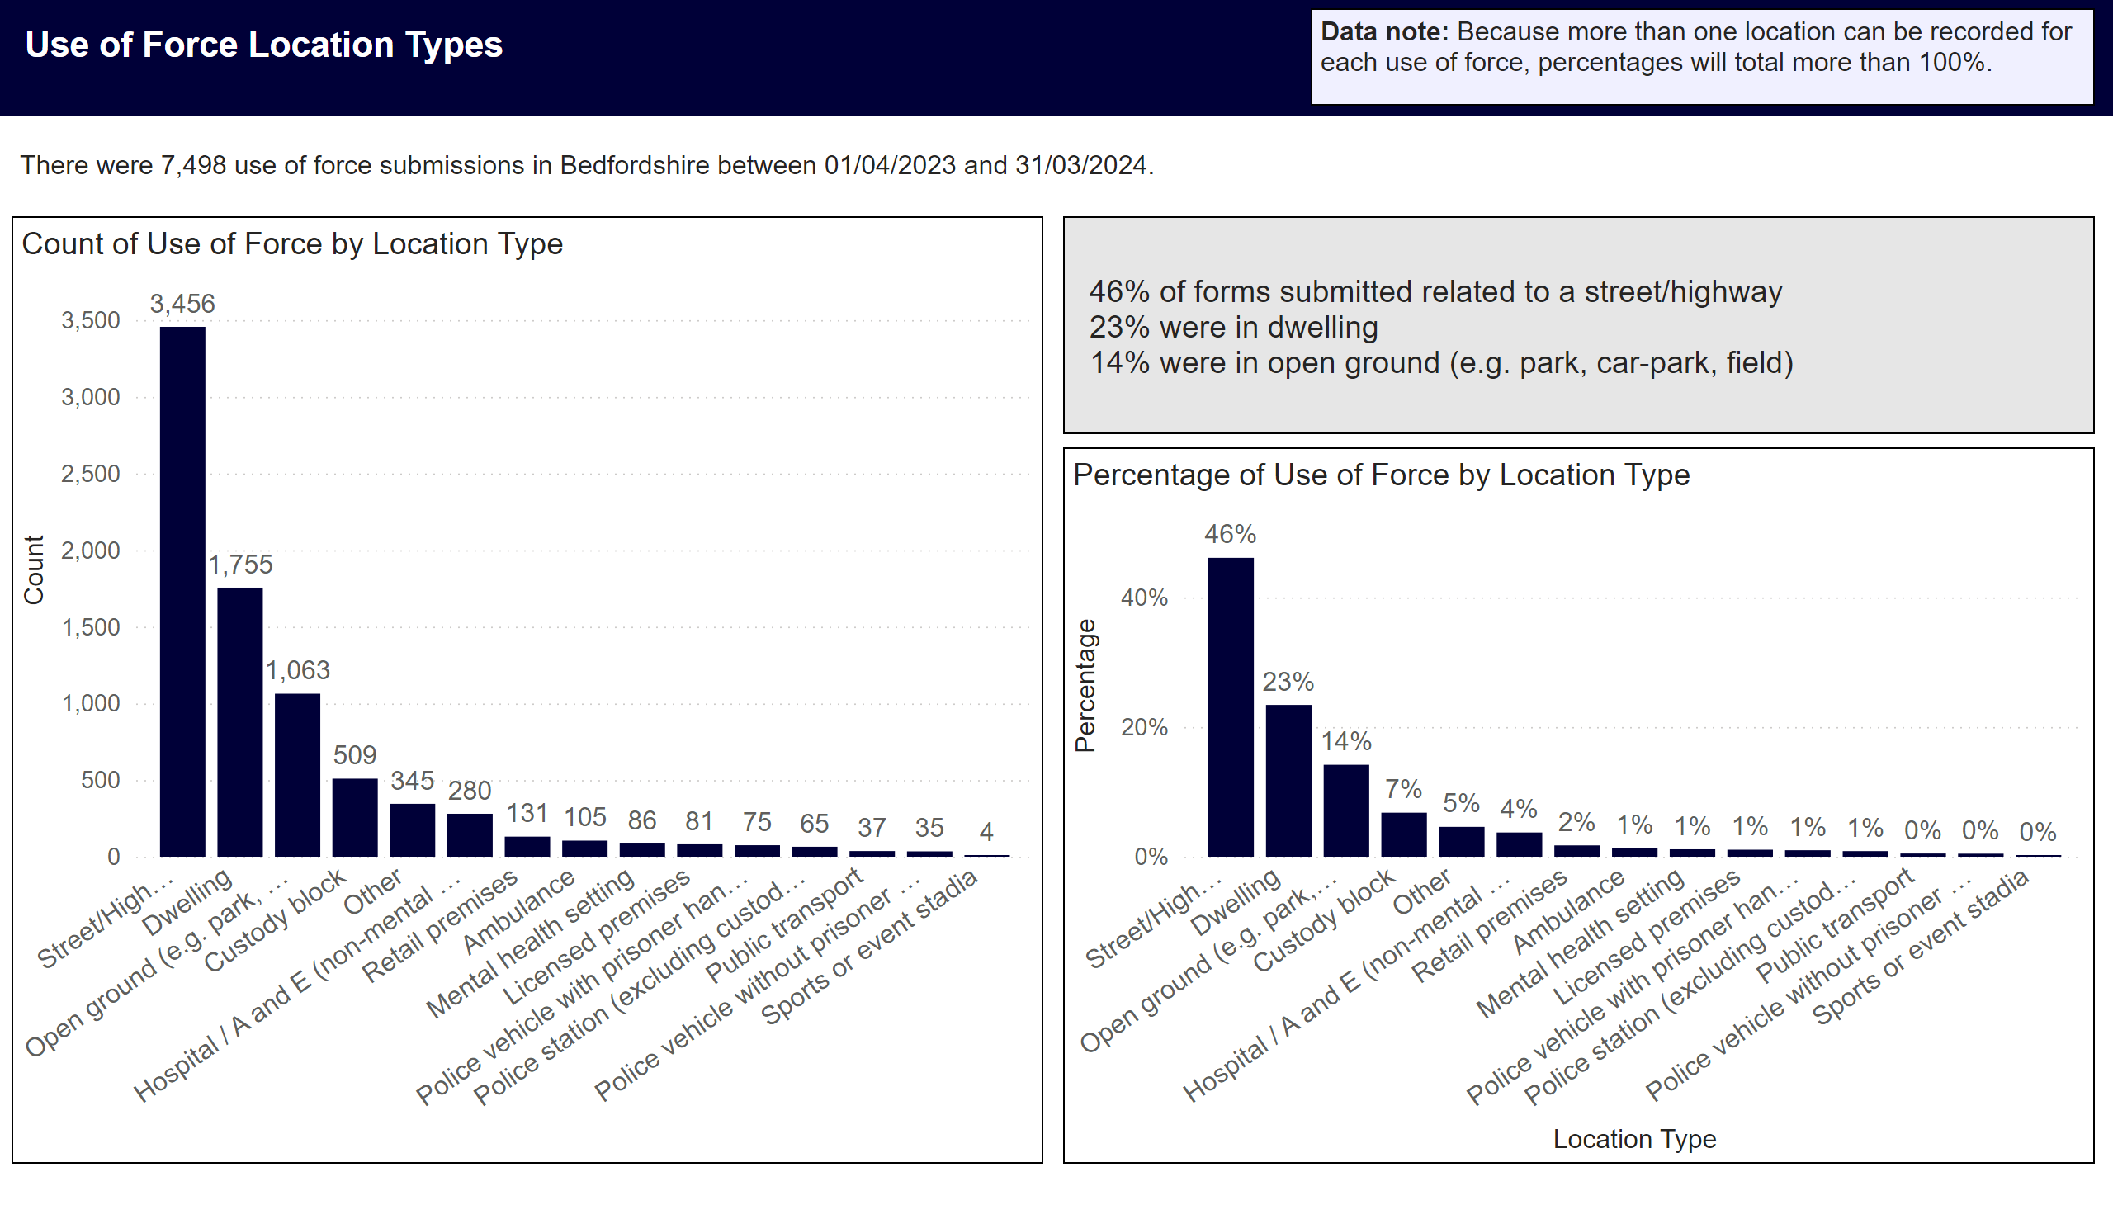
Location Type
Notes:
Data Note
Data note: Because more than one location can be recorded for each use of force, percentages will total more than 100%.
Overview
There were 7,498 use of force submissions in Bedfordshire between 01/04/2023 and 31/03/2024.
Top Three locations by percentage
46% of forms submitted related to a street/highway
23% were in dwelling
14% were in open ground (e.g. park, car-park, field)
Use of Force by Location Type
The top five use of force locations in the period were street/highway with 3,456 (46%), dwelling with 1,755 (23%), open ground (e.g. park, car-park, field) with 1,063 (14%), custody block with 509 (7%), other with 345 (5%).

Slide 5
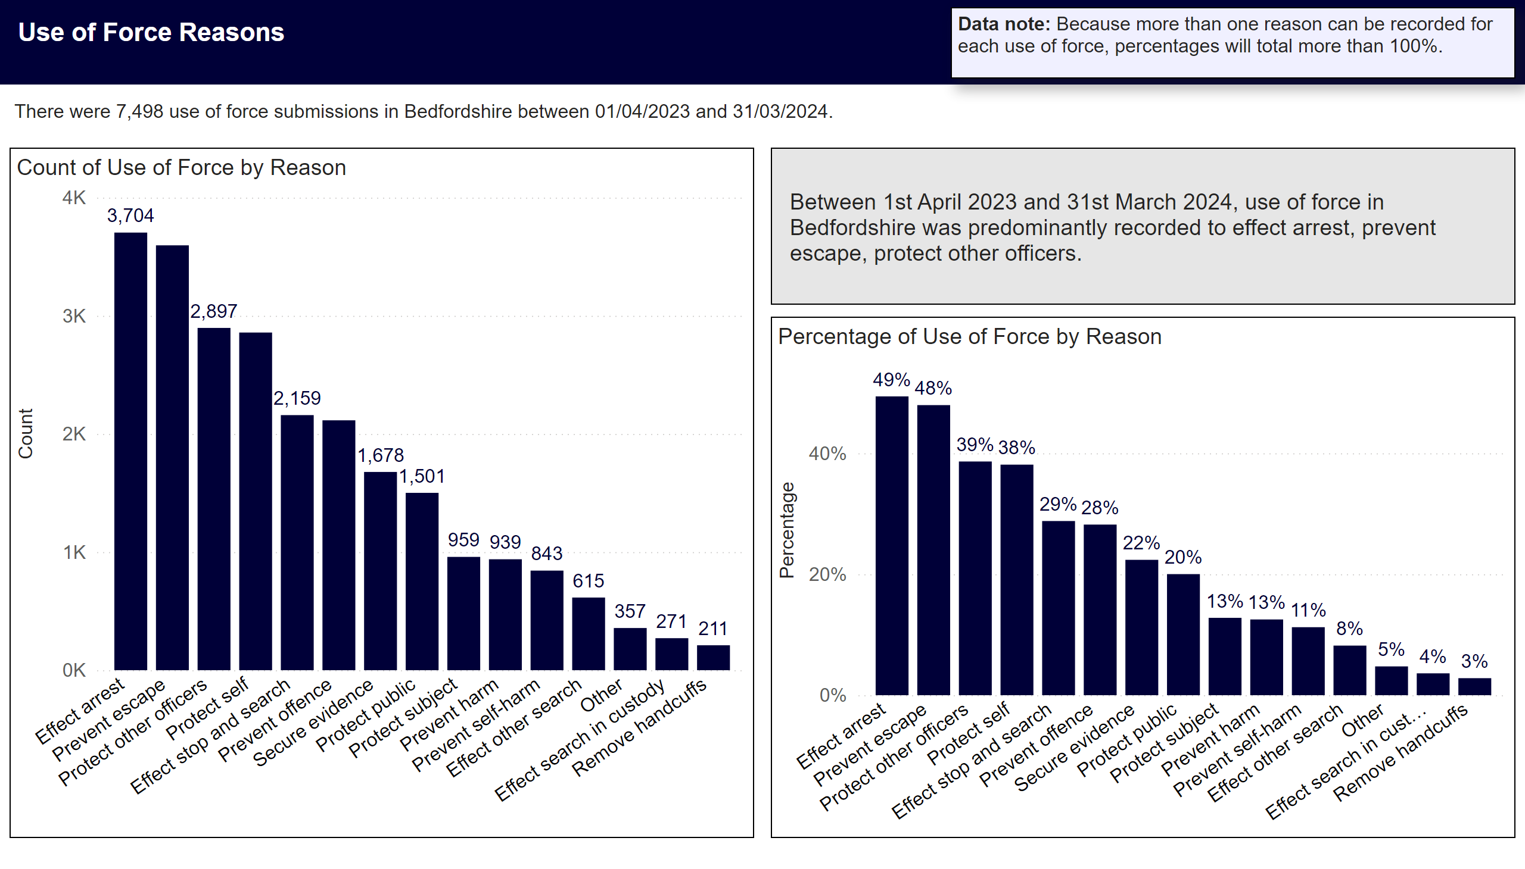
Reason
Notes:
Data Note
Data note: Because more than one reason can be recorded for each use of force, percentages will total more than 100%.
Overview
There were 7,498 use of force submissions in Bedfordshire between 01/04/2023 and 31/03/2024.
Top Reasons for Use of Force in Period
Between 1st April 2023 and 31st March 2024, use of force in Bedfordshire was predominantly recorded to effect arrest 3704 (49%), prevent escape (48%), protect other officers 2897 (39%).

Slide 6
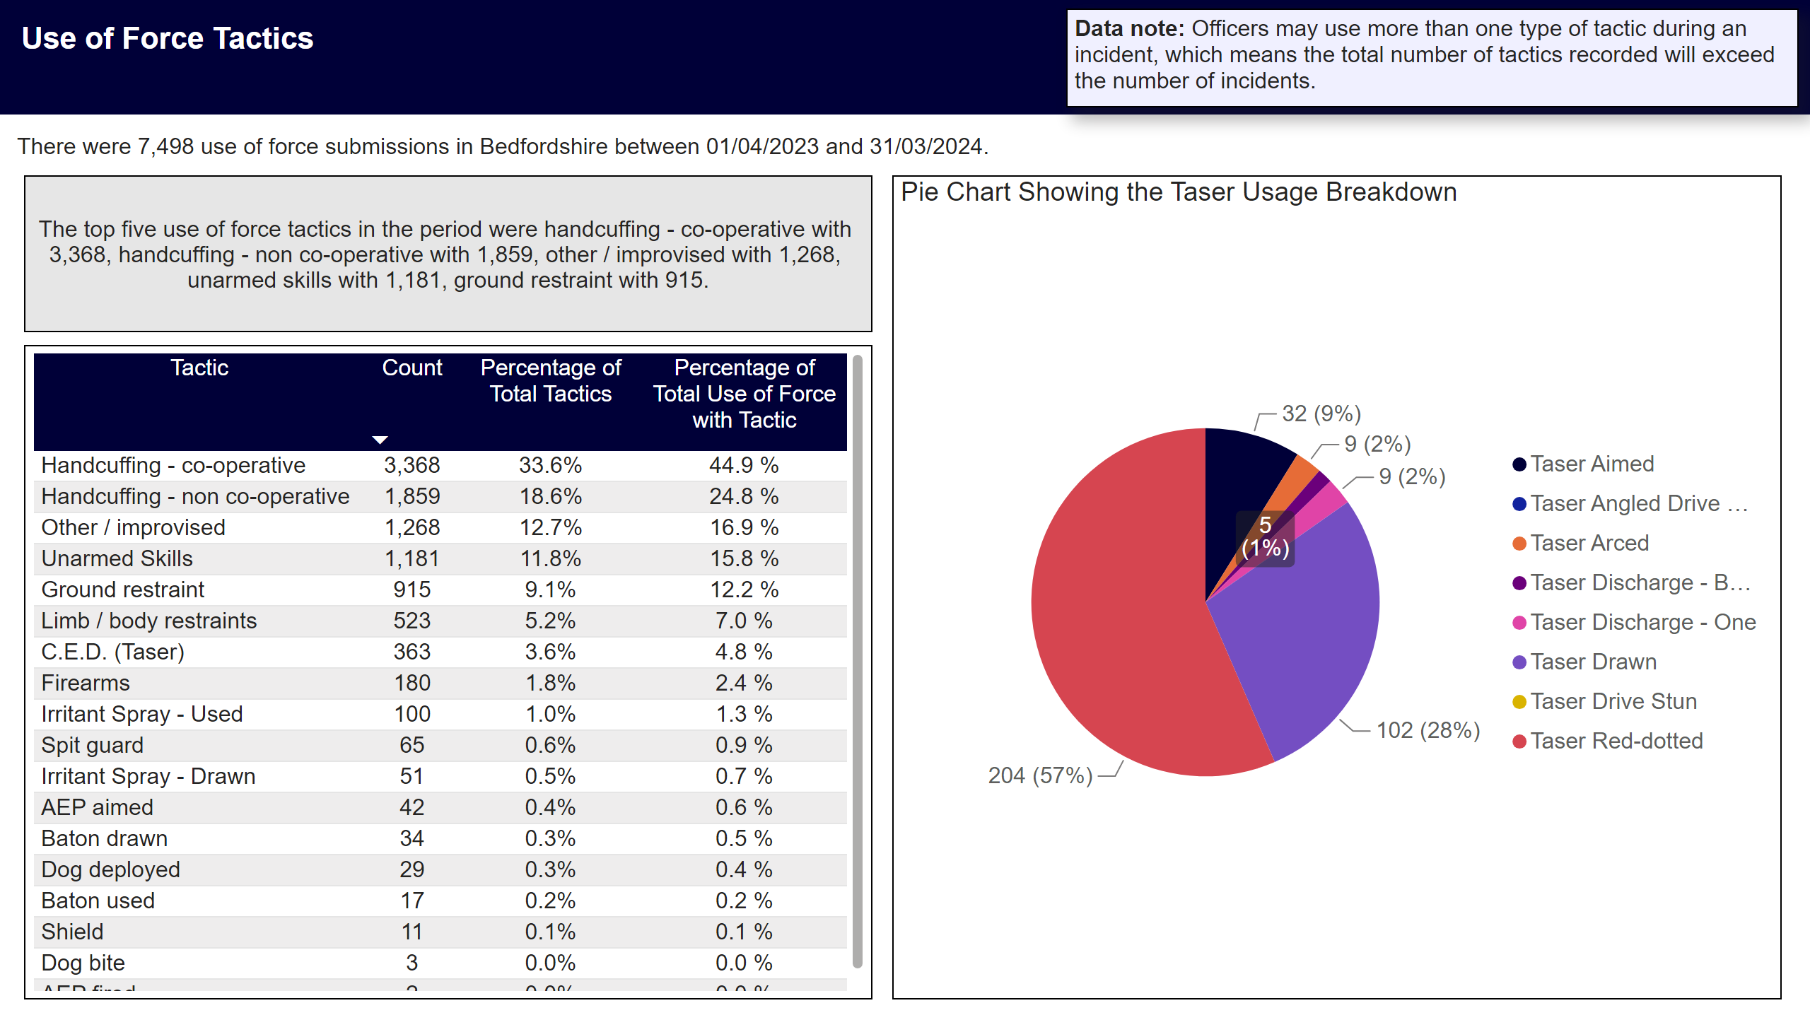
Tactics Used
Notes:
Title
Use of Force Tactics
Data Note
Data note: Officers may use more than one type of tactic during an incident, which means the total number of tactics recorded will exceed the number of incidents.
Overview
There were 7,498 use of force submissions in Bedfordshire between 01/04/2023 and 31/03/2024.
Table description
Table showing count of use of force by tactic used. Percentage of total tactics, and percentage of total use of force with tactic.
Top 5 Tactics Used
The top five use of force tactics in the period were handcuffing - co-operative with 3,368, handcuffing - non co-operative with 1,859, other / improvised with 1,268, unarmed skills with 1,181, ground restraint with 915.
Pie Chart Showing the Taser Usage Breakdown
Tasers were used in 363 instances of use of force in the period. 204 red-dotted, 32 aimed, 102 drawn, 0 angled drive stun, 9 arced, 14 discharged, 0 drive stun.

Slide 7
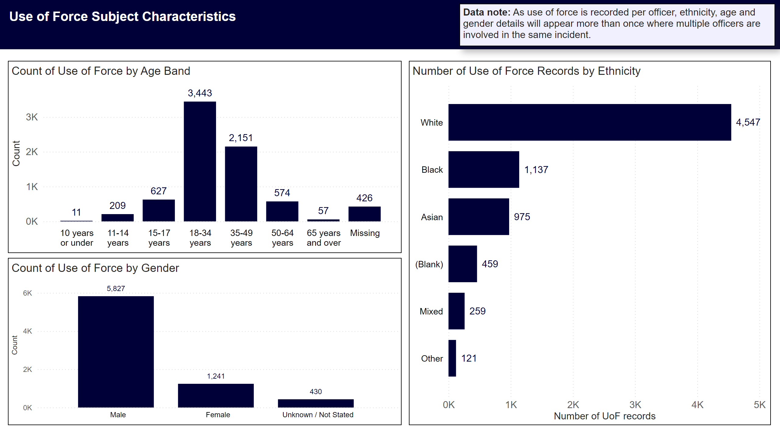
Subject Characteristics - Counts
Notes:
Title
Use of Force Subject Characteristics
Data Note
Data note: As use of force is recorded per officer, ethnicity, age and gender details will appear more than once where multiple officers are involved in the same incident.
Number of Use of Force Records by Ethnicity
Ethnicity breakdown was as follows White with 4,547, Black with 1,137, Asian with 975, with 459, Mixed with 259.
Count of Use of Force by Age Band
Top three age bands were18-34 years with 3,443, 35-49 years with 2,151, 15-17 years with 627.
Count of Use of Force by Gender
Gender breakdown male 5,827, female 1,241.

Slide 8
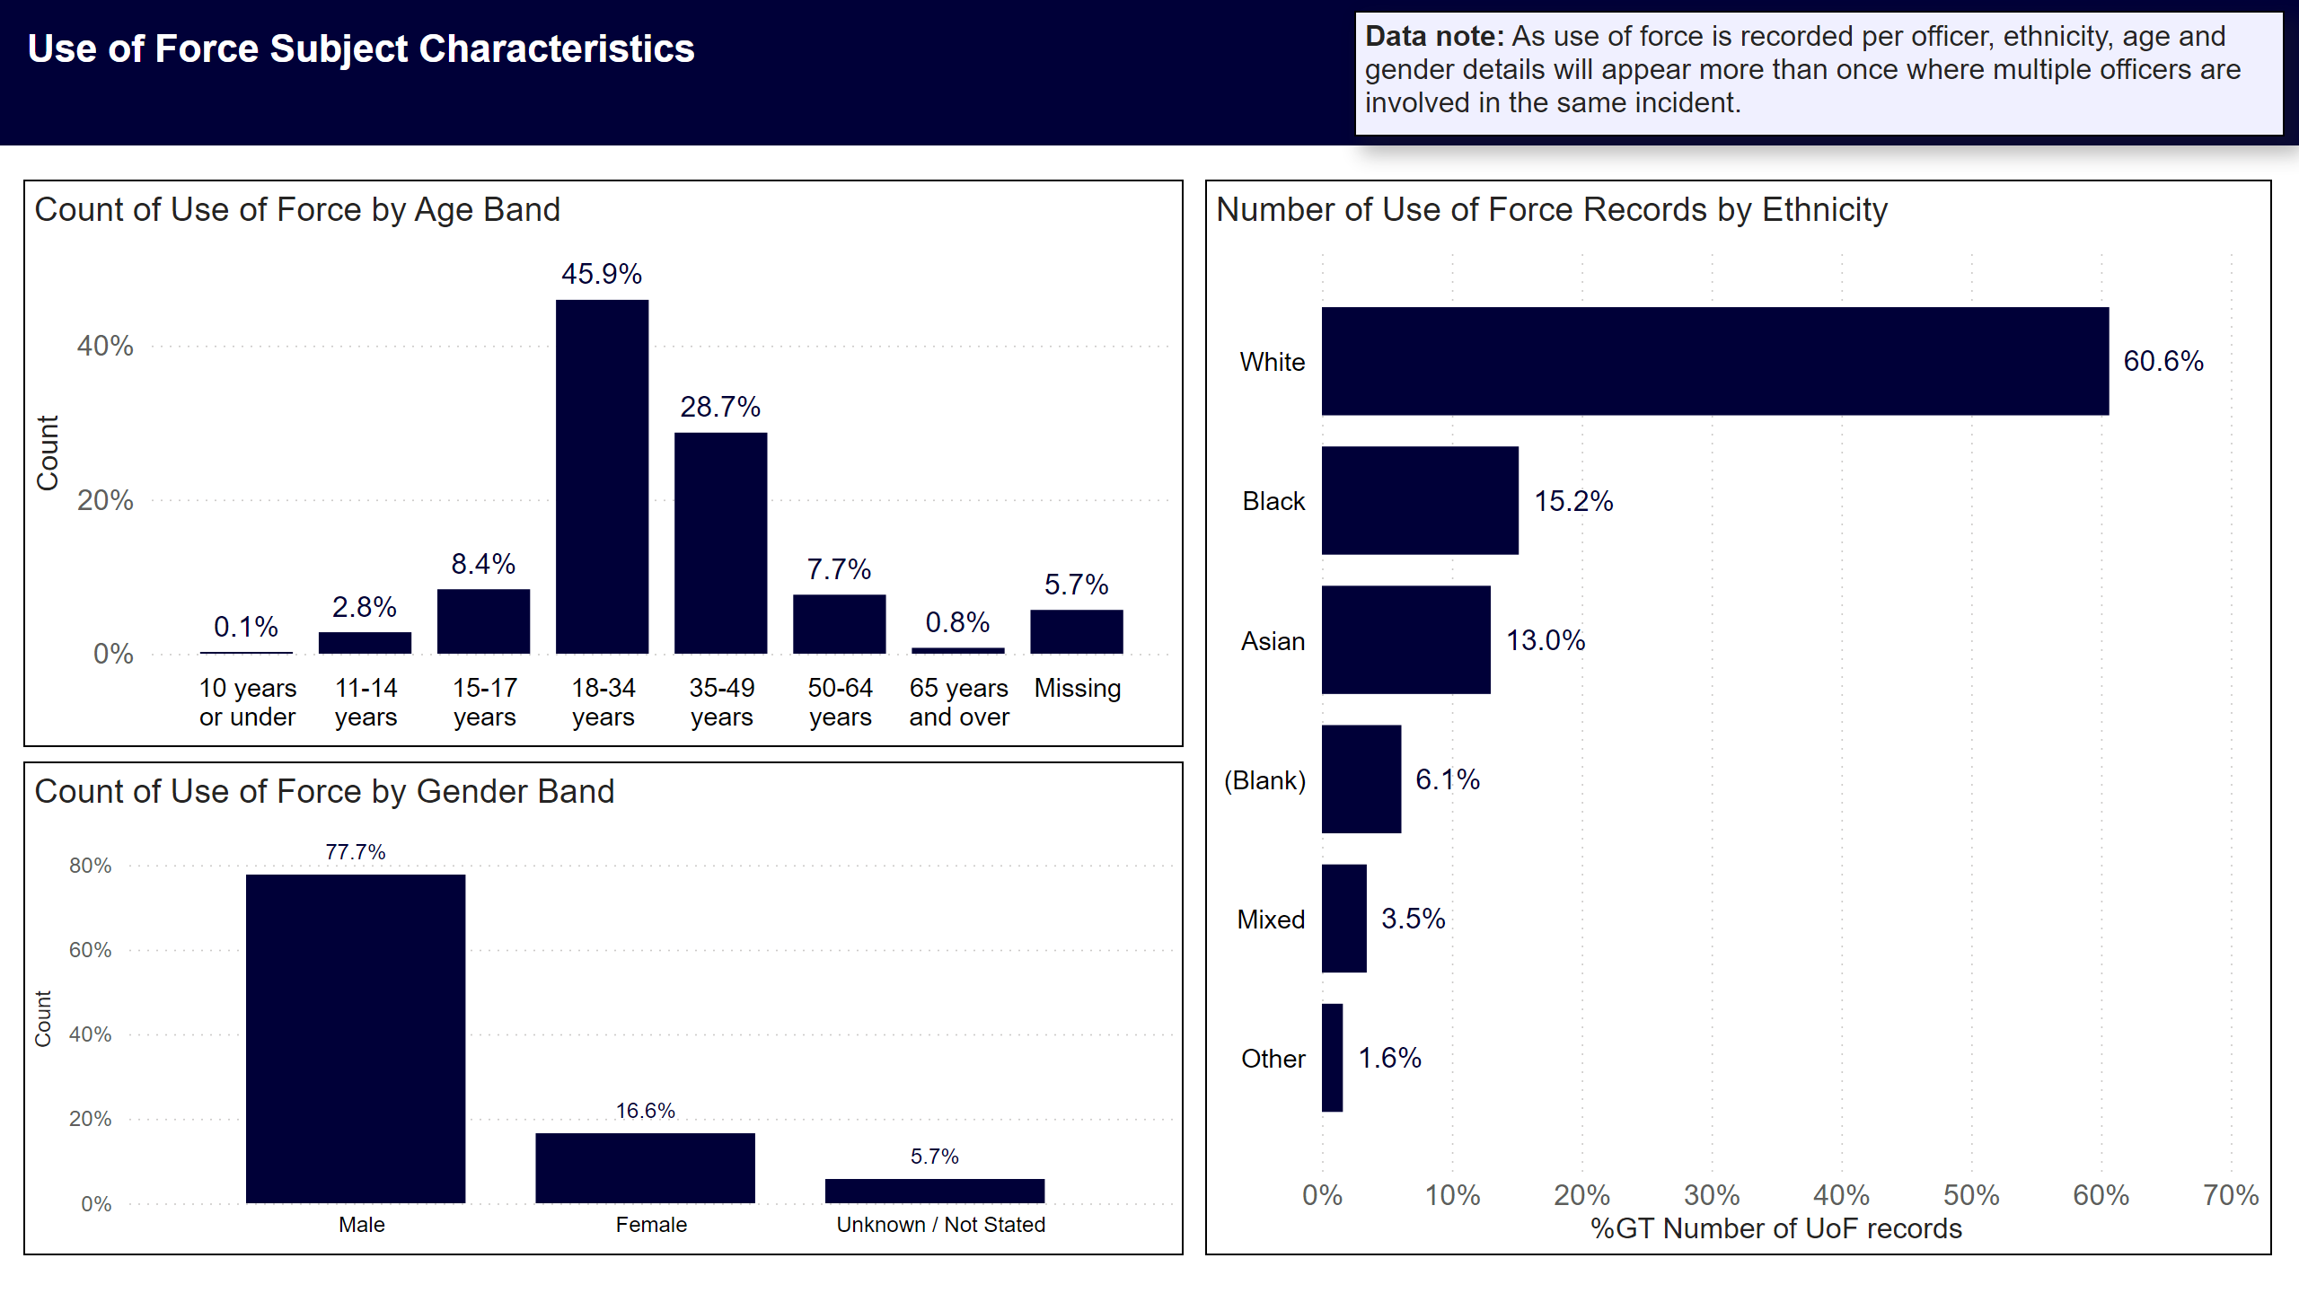
Subject Characteristics - Percentages
Notes:
Title
Use of Force Subject Characteristics
Data Note
Data note: As use of force is recorded per officer, ethnicity, age and gender details will appear more than once where multiple officers are involved in the same incident.
Count of Use of Force by Age Band
46% of forms submitted related to persons aged 18-34 years
29% were 35-49 years
8% were 15-17 years
Count of Use of Force by Gender Band
78% of use of force subjects were male
17% were female
Number of Use of Force Records by Ethnicity
61% of subjects were White
15% were Black
13% were Asian
6% were
3% were Mixed

